Slide 1
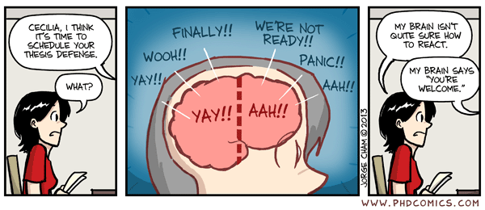
Practice your Defense!
Are you nervous because of an upcoming presentation?
Helmholtz-Juniors @GSI
Helmholtz-Juniors @GSI
Do you want to get feedback on a conference talk you have to give?
Are you looking for a possibility to practice your thesis defense?
Helmholtz-Juniors @GSI
Helmholtz-Juniors @GSI
You take care of
We take care of
Talk
Supervisor (optional)
Group members
Place
Announce
Audience
Feedback
Experts
No additional effort necessary, you can only benefit by practicing your talk.
Helmholtz-Juniors @GSI
Helmholtz-Juniors @GSI
write us:
helmholtz-juniors@gsi.de
Organized by:

