Slide 1
CS Framework Workshop 2013
Welcome!

Slide 2
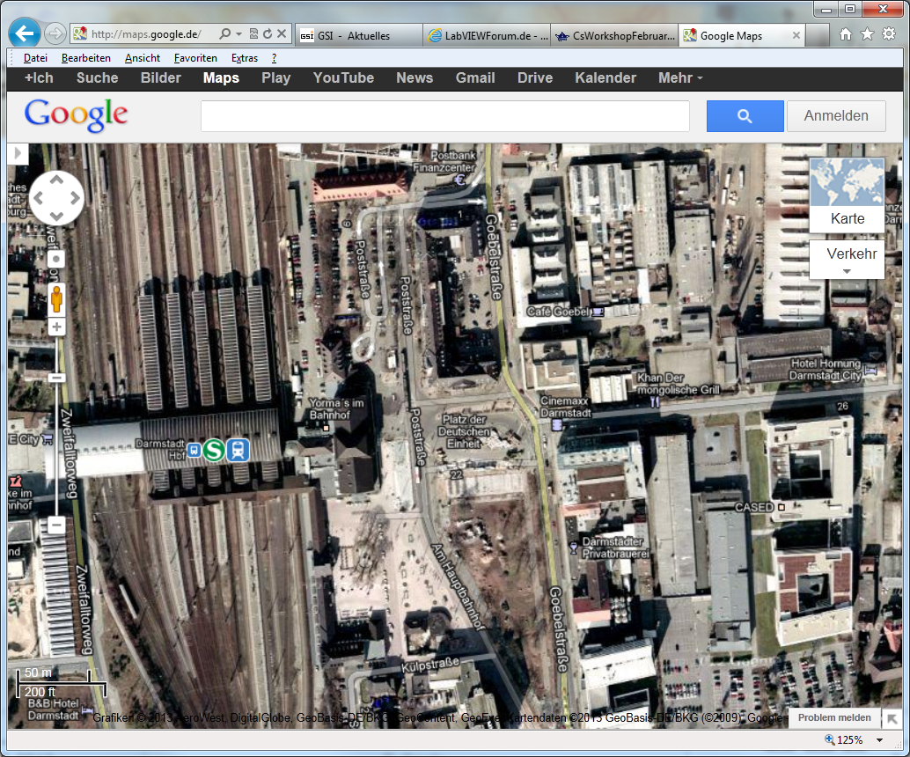
Organisational
Attendee list
Dinner
Please note whether you join the dinner.
We made a reservation for 12 persons.
Transportation
We could use the GSI bus and S-Bahn to go to Khan.
We could buy group tickets.
We could go by car.
Workshop photo

Slide 3
Thoughts about CS Future
Inventors of CS are busy with other projects for FAIR
Dennis Neidherr will maintain CS_Main Package and
Packages necessary for HITRAP & MATS
Who takes over the maintenance of other packages & classes?
Upgrade to new LabVIEW Version 2012?
Integration of LVOOP?
Native support by NI
CS Integration
CS base classes using LVOOP
Example: IMAQDevice using HGF_IMAQ
Independent NI Actor Framework application
Connected to CS via DIM
Long term perspectives?
Which is the driving project?
Software, which is not actively developed or maintained by the community, is dead!

Slide 4
Wiki & Sourceforge
CS@wiki.gsi.de
Central place for CS documentation
Most contribution stem from Dietrich!
Only very few other authors.
Outdated documentation is at least misleading or even worse: useless!
CS@sourceforge.net
Mailing list: Cs-framework-info is rarely used.
Do we really need it?
Forum & Tracker are rarely used.
Do we really need it?
Alternative: forum.gsi.de
Frequent SF changes
Maintenance of CS@Sourceforge.net?
(Un-)Packager?
Central place for download of released packages.
Alternative: Distribution using VI Package Manager? (VI Package Manager is pushed by NI.)

Slide 5
Source Code Control
No substitute for backup!
Subversion
Central repository
World wide accessible, but needs online connection.
Head revision contains most recent developments.
Individual classes or packages can be updated to specific revisions in order to match corresponding releases.
Branching is possible but seldom used.
Quality assurance
Commit permissions restricted to responsible (group of) developer
Observed behavior
Checkout once
Never update – risk to miss important updates or bug fixes!
Commit seldom or never – in contradiction to collaboration!
Alternative: Git – Distributed Version Control System
Can be used as subversion client.
Allows local offline commits.
More flexible, but needs more discipline.
Chance to get rid of history
Keeps a release repository slim!

