Slide 1


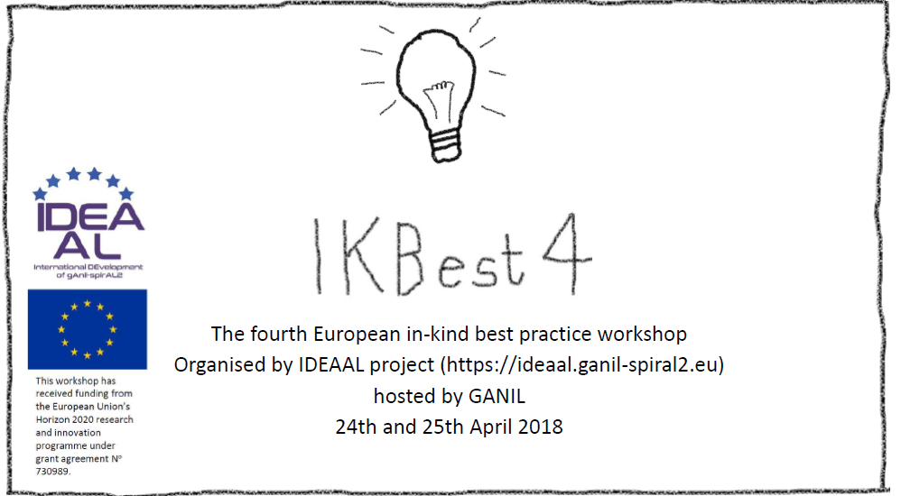
Introduction to GANIL

Slide 2
GANIL: some features
1976: creation of GANIL
1983: first experiment
2001: SPIRAL1 exotic beams
2005: launch of the SPIRAL2 project
2015: renewal of the status of
GANIL for 30 years
2017+ : commissioning of SPIRAL2 Phase1
Mid/long term future: beyond SPIRAL2 Phase1
Hosting platform
  ~ 300 staff (CEA, CNRS)
  ~6200 hours of experiments in 2017
  Users: ~ 700 researchers
    ~ 100 laboratories
  Industrial applications (10%)
Scientific Production/ Animation
  ~ 150 publications /year
  Organization of ~15 international conferences/year
Training
  50 students /year (Post-doc, PhD, trainees)
  teaching activities
  ~ 1500 visitors/year

Slide 3

GANIL: international context
One of the major facility in the world for exotic ion beams
With RIBF/RIKEN (Japan), GSI/FAIR (Germany), MSU (USA), ISOLDE (CERN) …
Projects / Collaborations
  2 EQUIPEX , 6 ANR since 2007
  1 ERC grant
  Coordination of 5 European projects: ENSAR, SPIRAL2PP, EURISOL, ENSAR2, IDEAAL
  Participation in 5 European projects : LA3-NET, MATNEC, EMILIE, SARFEN, CHANDA
  International collaboration agreements:18 MoU, 6 LIA
❖
❖
❖
✚
❖
❖
❖
❖
✚
❖
❖
❖
✚
✚
❖
❖
❖
✚
❖
❖
❖
✜
❖
✜
✚

Slide 4
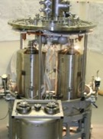
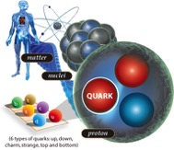
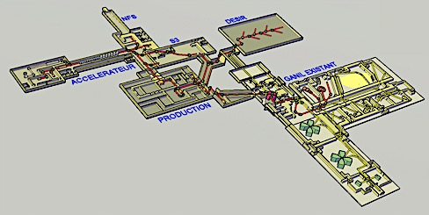





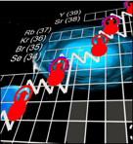
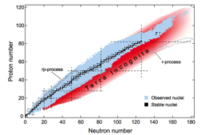


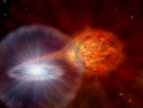
GANIL SPIRAL2
Very intense stable ion beams
Exotic ion beams
Very intense neutron source
Accelerator science
& Technology
Fundamental Interactions
Multidisciplinary research and applications
Nuclear structure
and reaction
Nuclear astrophysics

Slide 5

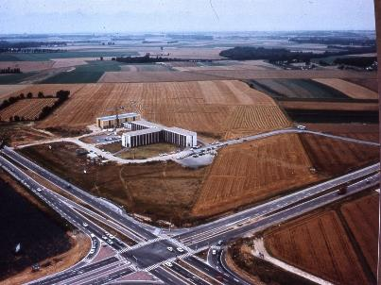
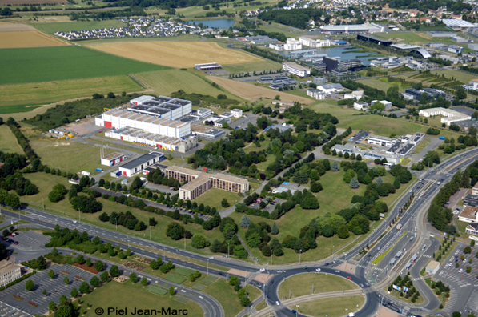
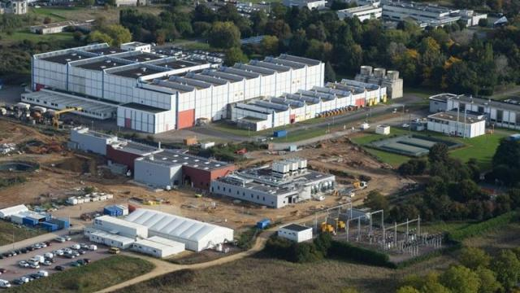
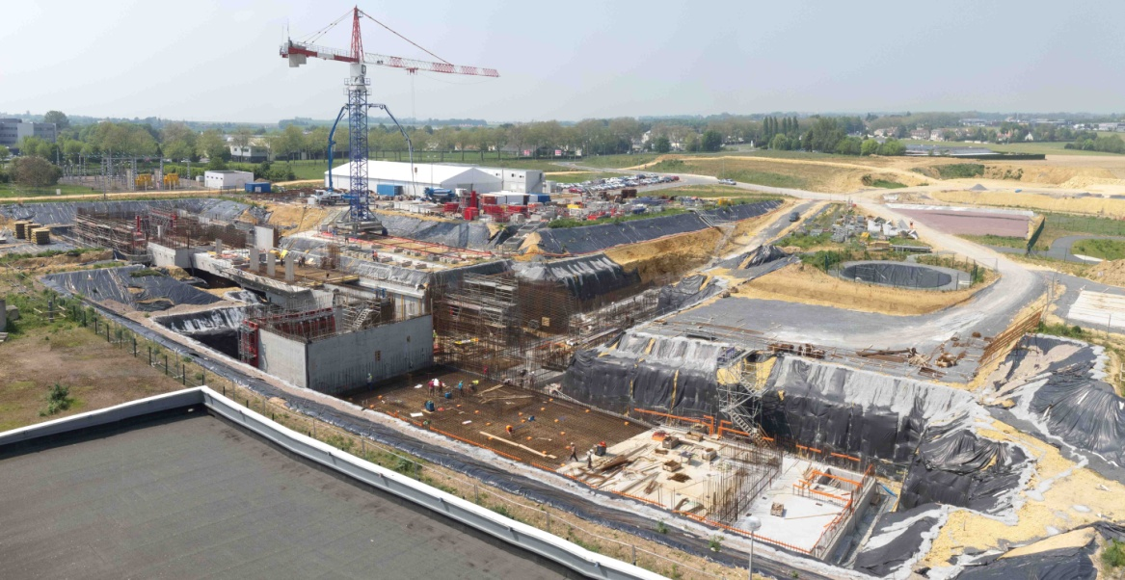
Evolution of the facility
Evolution
1978
yesterday
today
SPIRAL2
Phase 1
16 janvier 2018
5

Slide 6
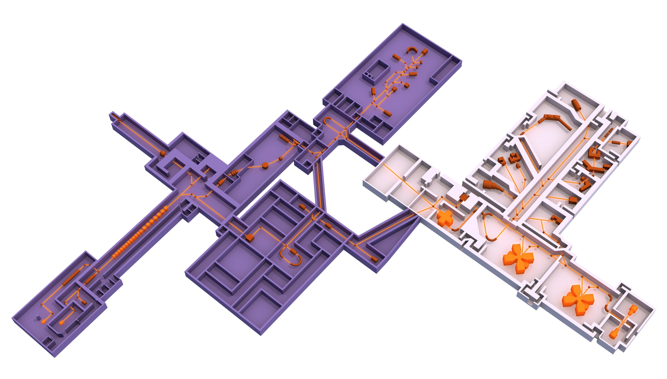
GANIL - SPIRAL2
DESIR
SPIRAL2
Phase 1
NFS
GANIL
S³
SC Linac
A/Q=7
Production
up to 10¹⁴ FF/s
A/Q= 2 & 3
SPIRAL2 :
Phase 2

Slide 7
















Collaborations and SPIRAL2
French partners
International collaborations
GANIL
Since 2006 :
Infrastructure & accelerator ≈ 1000 FTE
Experimental halls ≈ 250 FTE
LPC
IPHC
DRF
LAL
LPNHE
Subatech
IPNO
CSNSM
DAM
DEN
CENBG
IPNL
LPSC
SPIRAL2
GSI – Fair (D) INFN-Legnaro (I)
Isolde (CERN) INFN-Catane (I)
IFIN-HH (RO) TRIUMF (CDN)
SOREQ (IL) CIEMAT (E)
BARC (IND) Huelva (E)
Argonne (USA) IFJ-PAN (PL)

Slide 8
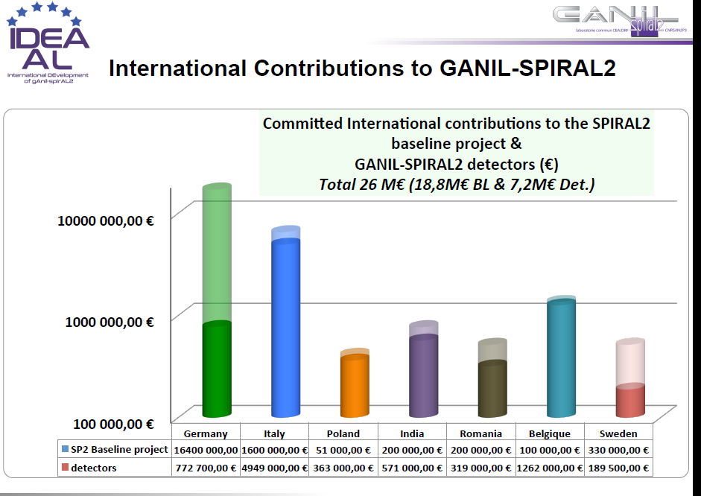

Slide 9
One possible scenario (in april 2018 (depending on the ASN decision))
2016 I 2017 I 2018 I 2019 I 2020
4,5 m.
4 m.
4 m.
~ 5 months(constraints SP2, RXS)
SPIRAL1 tests
SPIRAL1 new beams
GANIL cyclotrons
AGATA @ GANIL withVAMOS, NEDA, MUGAST, Gas filled …
LISE
LISE
Upgrade LISE + LISE
FAZIA/
INDRA
LINAC
Source RFQ
1re exp. NFS
cooling RF(?) ASN decision
S3 : building, assembly
SPIRL2 Phase 1
DESIR : MOE
DESIR building

Slide 10
WP2 of the IDEAAL project:
Procedure of evaluation of in-kind contributions and their monitoring
on-going discussion to increase the number of GANIL partners (internationalization of GANIL)

Slide 11
WP2 of the IDEAAL project:
Procedure of evaluation of in-kind contributions and their monitoring
on-going discussion to increase the number of GANIL partners (internationalization of GANIL)
Important to find a successful in-kind model: a balance of the needs/possibility of all partners

Slide 12
WP2 of the IDEAAL project:
Procedure of evaluation of in-kind contributions and their monitoring
on-going discussion to increase the number of GANIL partners (internationalization of GANIL)
Timing: many things have evolved since the signing of the first collaboration agreements and Cohabitation of projects at different stages
Important to find a successful in-kind model: a balance of the needs/possibility of all partners

Slide 13
WP2 of the IDEAAL project:
Procedure of evaluation of in-kind contributions and their monitoring
on-going discussion to increase the number of GANIL partners (internationalization of GANIL)
Timing: many things have evolved since the signing of the first collaboration agreements and Cohabitation of projects at different stages
Important to find a successful in-kind model: a balance of the needs/possibility of all partners
→ Important to calculate the effective value of contributions for delivery, storage, installation, commissioning and repair in an in-kind context

Slide 14
Thank you for your participation

