Slide 1
Dynamic UIs @ LabVIEW RT
using Actor Framework
Alexander Kessler
Helmholtz Institut Jena
CS-Workshop 2019, 2019/03/19

Slide 2
Motivation
A lot of motion application, which differs only in UI!
Wish for highly flexible motion application
Many discussions in NI user forums and presentation during NI VIP 2017
Understanding: I have already everything I need

Slide 3
History
Usage of Actor in Subpanel technique
For that: AF Class Viewable Actor (based on SimonH Windows 8 Style UI Framework https://forums.ni.com/t5/UI-Interest-Group-Documents/Windows-8-Style-UI-demo/ta-p/3496737 )
Vis: Insert Into SubPanel, Remove from SubPanel, Open Front panel, Set Window Title
Memorize last window size and position
Relaunch with same geometry
Child class ViewableActorEncaps: shows parent UI in child UI

Slide 4
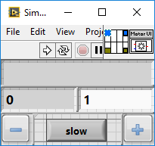
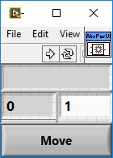
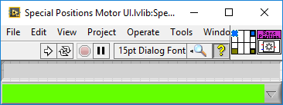
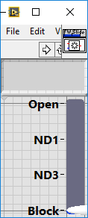
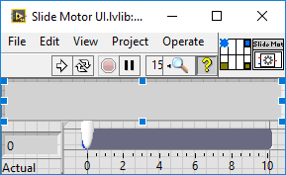
History
Motor UIs <- Base UI <- Viewable Actor
Are nice resizable due to LV slider technique

Slide 5
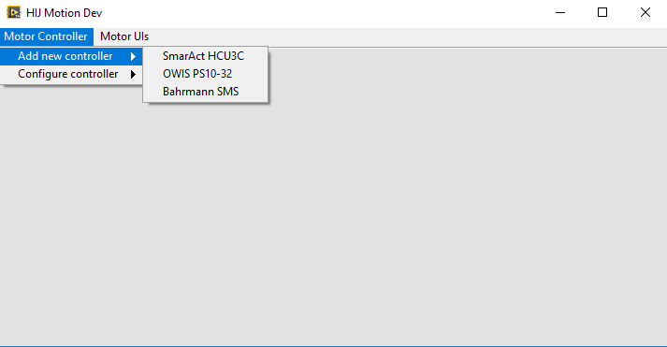
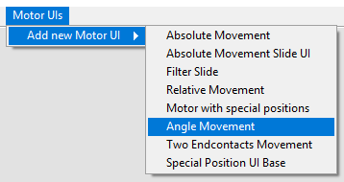
Idea
A container actor with a lot of invisible Subpanels and a dynamic menu

Slide 6
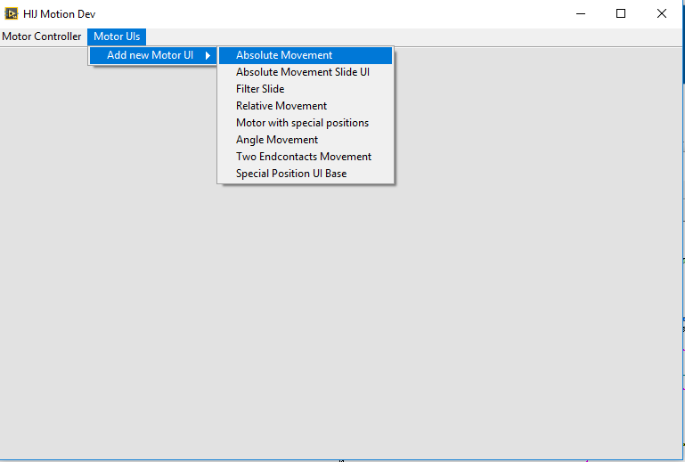
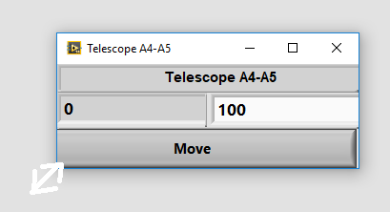
Idea
Creates and configure Motor GUIs
Connect to a controller axis
Docks UI
1.
2.
3.

Slide 7
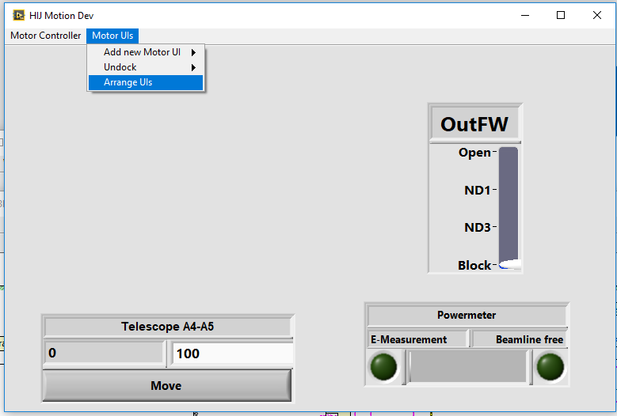
Idea
Change in drag mode -> mouse icon = “move”
Drag GUIs to desired position

Slide 8
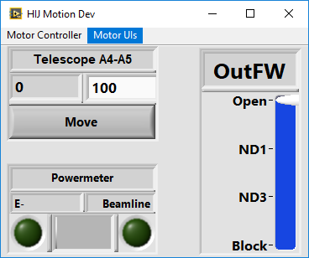
Idea
Move GUIs to desired position
Disable drag mode -> finished!

Slide 9
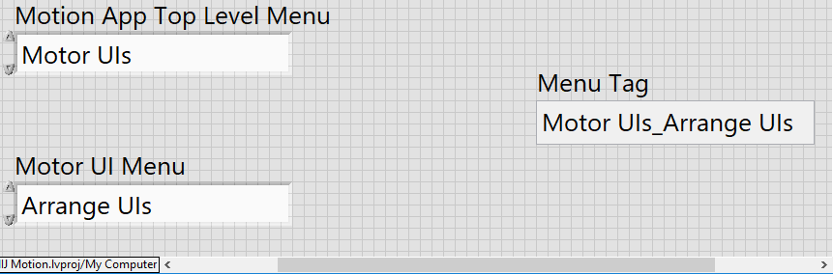
Some LV Tricks
Scan from String and Format into String.vi works well with enums!
Use what for menu tags!

Slide 10
Some LV Tricks
Find all child classes (Based on QueyeYueue LAVA Post https://lavag.org/topic/18973-list-children-classes/?do=findComment&comment=114169 )
Extract class name without prefix and suffix

Slide 11
Dynamic menu
Build menu tags in snake case style TopLevelTag_SecondLevelTag_ThirdLevelTag
use enums instead of text (change menu name in enum definition)

Slide 12
Dock a motor GUI
Get window size from GUI (reply msg of Viewable Actor)
Set size of subpanel and shift it at mouse position
Send Insert into Subpanel Msg to GUI

Slide 13
Arrange GUI
Change in drag mode @ menu selection (change mouse icon and set menu item checked)
VI Ref for
Viewable Actor
Viewable Actor
Send Open FP

Slide 14
Arrange GUI
Initialize drag mode @ mouse down if mouse is inside an used subpanel

Slide 15
Arrange GUI
Catch mouse movement and shift subpanel

Slide 16
Arrange GUI
Reset drag mode @ mouse up event

Slide 17
Summary
Dynamic UIs are quite easy with AF and suitable base class https://git.gsi.de/a.kessler/ViewableActor.git
Avoid trouble with strings, use enums
Simple implementation of dynamic menus
VI to find all child classes
Reference application HI-Jena motion https://git.gsi.de/a.kessler/HIJ_Motion.git

