Slide 1
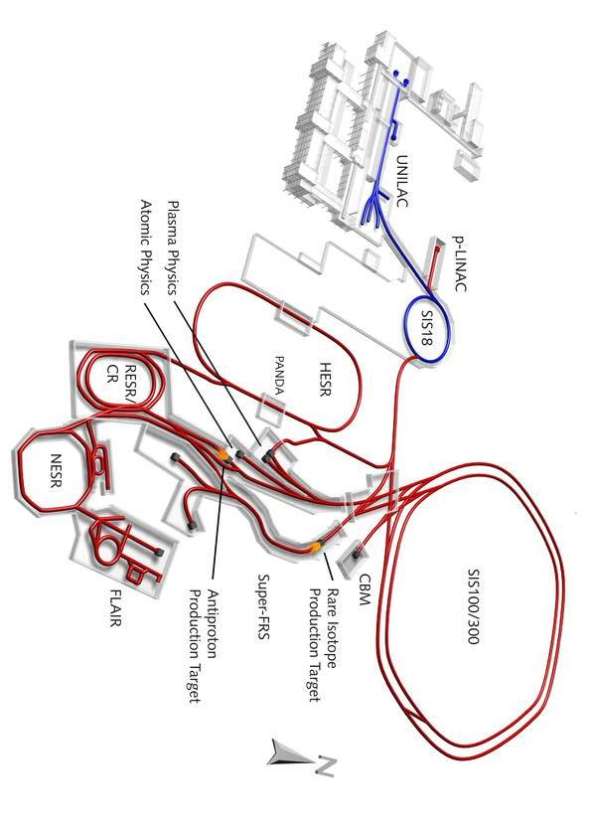
Procurement Status
FAIR Subproject Detectors
30.01.2015

Slide 2
2. Überarbeitete Auflage (2015)
Autor: Dr. Jens Stadlmann
GSI Helmholtzzentrum für Schwerionenforschung GmbH
Druck: Roland Kurz, GSI Campus Druckerei
Auflagenanzahl: 25 Stk.
Alle Rechte vorbehalten GSI Helmholtzzentrum für Schwerionenforschung GmbH

Slide 3
The following items are examples of completed R&D activities and launched procurement processes for major subsystems of FAIR experiments.
The shown items are representing only a small fraction of the ongoing processes and the processes in preparation for procurement on short term.

Slide 4
Index of Contents
Index of Contents
Index of Contents | 4
APPA | 5
BioMat Detectors | 18
CBM Detector | 21
NUSTAR Detectors | 34
Panda Detector | 68
Plasma Physics Detectors | 82
4

Slide 5
APPA
Mats
Laser/SIS100
SPARC/HESR
Cryring/ESR

Slide 6

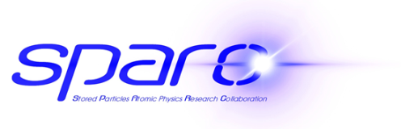










SPARC
Collaboration for SPARC
(Stored Particles Atomic Physics Research Collaboration) :
FZ Jülich, Germany
HCJRG-108
Helmholtz Association, Helmholtz Institute Jena, Germany
Helmholtz Center Dresden Rossendorf (HZDR), Germany
Johannes Gutenberg University Mainz, Germany
Johann Wolfgang Goethe University Frankfurt Main, Germany
Justus-Liebig-University Giessen, Germany
OPac
Technical University Darmstadt, Germany
University Kassel, Germany
Westphalian Wilhelms-University Münster, Germany

Slide 7
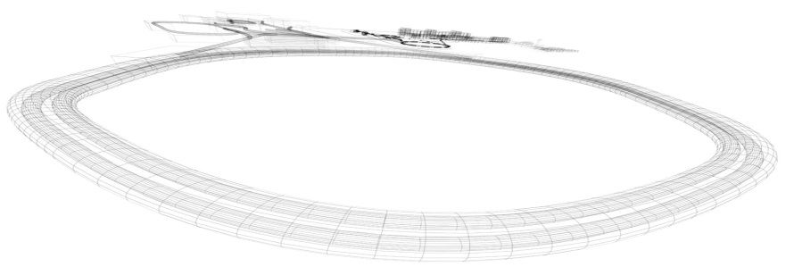
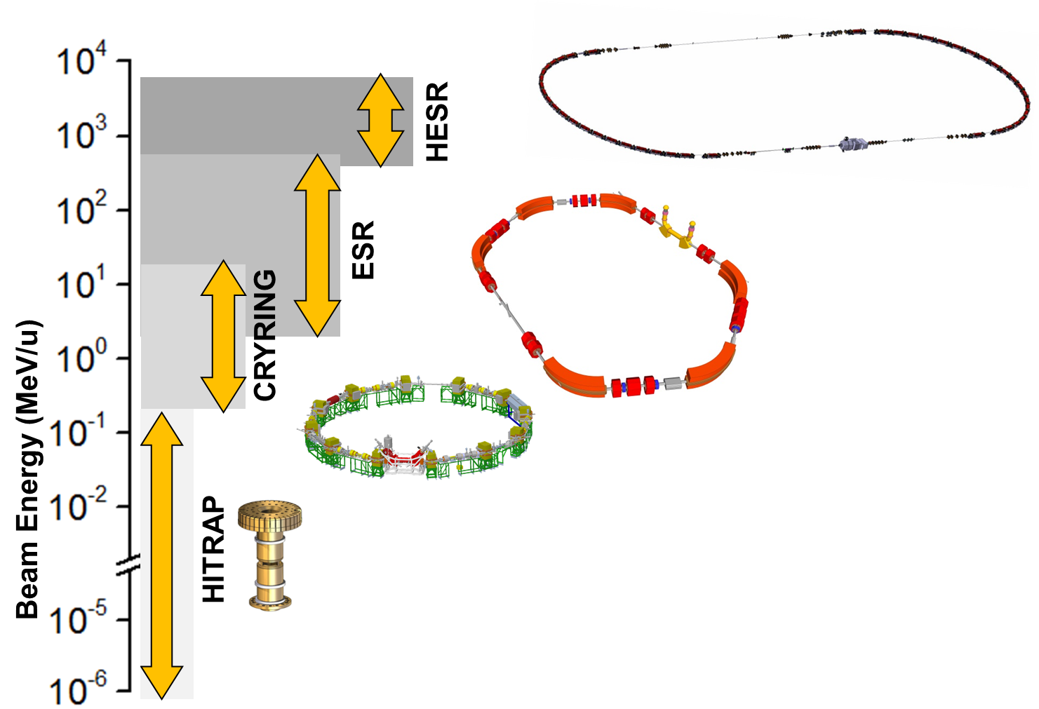
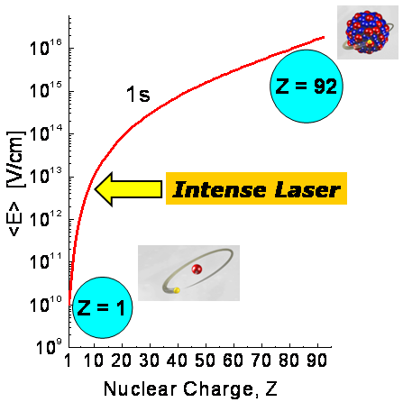
SPARC@FAIR: Storage and Trapping
Highly-charged ions in a broad range of energies
SIS100
max 29 GeV (pbar)
SIS100
max 14 GeV (pbar)
APPA
QED in the non-perturbative regime
Correlated multi-body dynamics for atoms and ions
Precision determination of fundamental constants
Influence of atomic structure on nuclear decay properties
    Fundamental physics and antimatter

Slide 8
SPARC@HESR
Pair-Production Phenomena
  Non-perturbation regime (αZ₁≈αZ₂≈1)
  Multiple pairs
  Negative continuum dielectronic recombination
Radiative Processes
  Recombination (polarization phenomena etc.)
  Photon-photon angular correlation
Target Ionization
  Correlated electron motion – exploring the ultrafast,
  Extremely strong transient fields of relativistic ions
Electron Impact Phenomena
  Electron impact excitation and ionization
Bound State QED and Nuclear Parameters
  Laser excitation in Li-like ions (Δn = 0)
Laser Interaction at High γ
  Test of special relativity
  Laser cooling
  Laser assisted pair creation
Fundamental Physics
  PNC effects in high-Z ions
Experiments at the border between Atomic and Nuclear Physics
  Radioactive decays of bare and few-electron ions
APPA

Slide 9
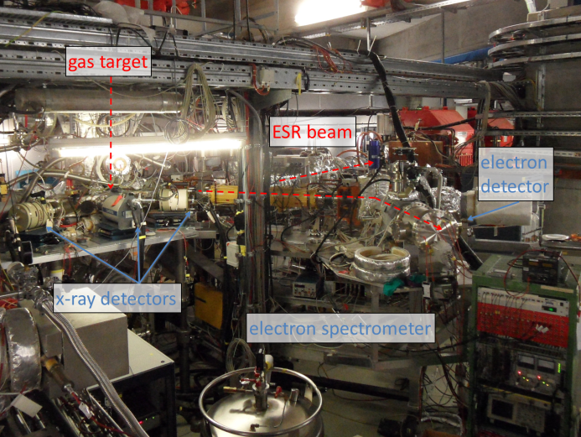

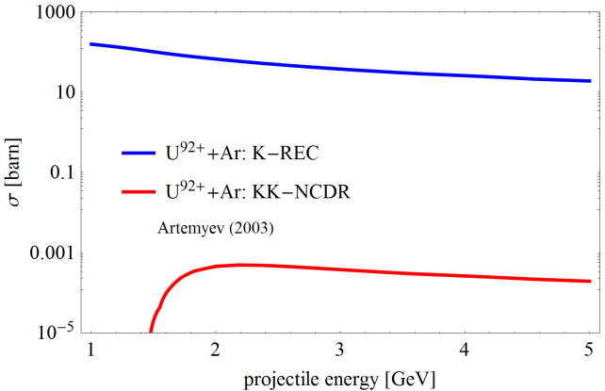
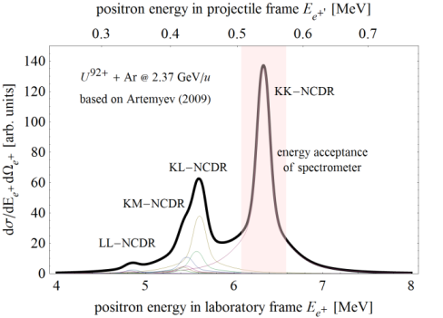
Electron - Positron Spectroscopy@HESR
Atomic electron-positron pair production in
heavy-ion-atom collisions studied at the HESR
Relativistic electron spectroscopy at storage rings
has been successfully demonstrated at ESR
Physical Review. A 90, 022707 (2014), Physical Review A 90, 042713 (2014)
Negative-continuum dielectronic recombination is theoretically predicted but not yet observed, the collision energy corresponds directly to HESR
APPA
Design study SPARC@HESR TDR
P.-M. Hillenbrand, et al.,
Phys. Scr. T (2015) in press
Physical Review A 67, 052711 (2003), Physical Review A 79, 032713 (2009)

Slide 10
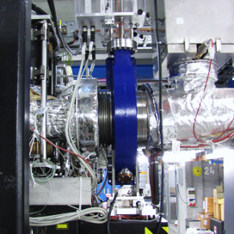
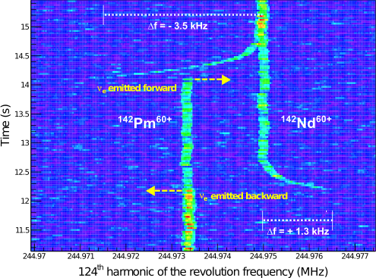
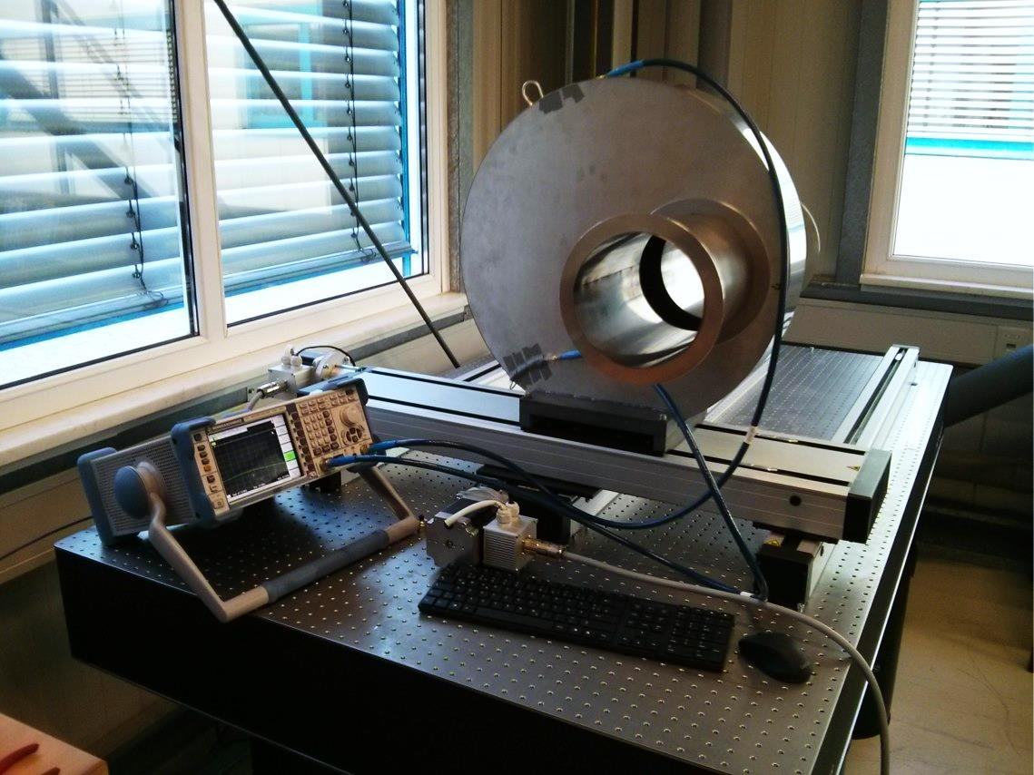
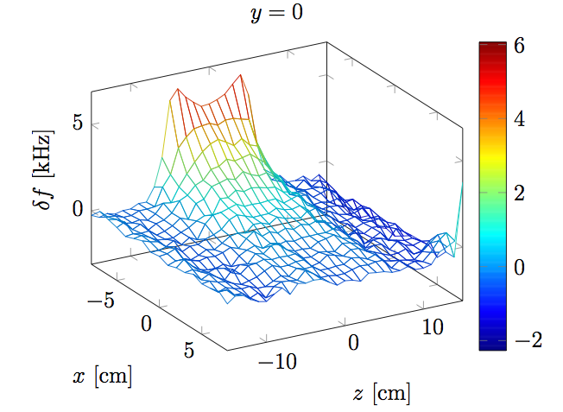

Resonant Schottky Cavities
Implementation and Characterization at the ESR
Novel Designs for FAIR rings
CR: Longitudinal and Transversal
HESR: Longitudinal
CRYRING: Tubular Schottky detectors
Detector installed at the ESR
(Photo by I. Petri, GSI)
Excellent performance enabling
single-ion decay spectroscopy
P. Kienle et al.,Phys. Lett. B 726 (2013)
Test-Laboratory at LBH at GSI
APPA
Non-destructive, continuous intensity measurement
ESR: Resonant Schottky (orange), DCCT (green)
Source: X. Chen et. al. Phys. Scr. T (2015) in press

Slide 11
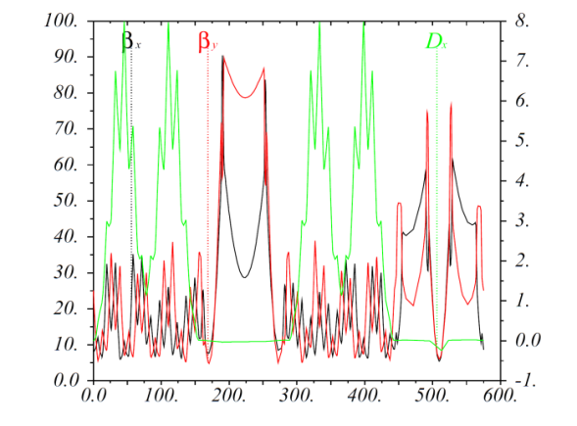
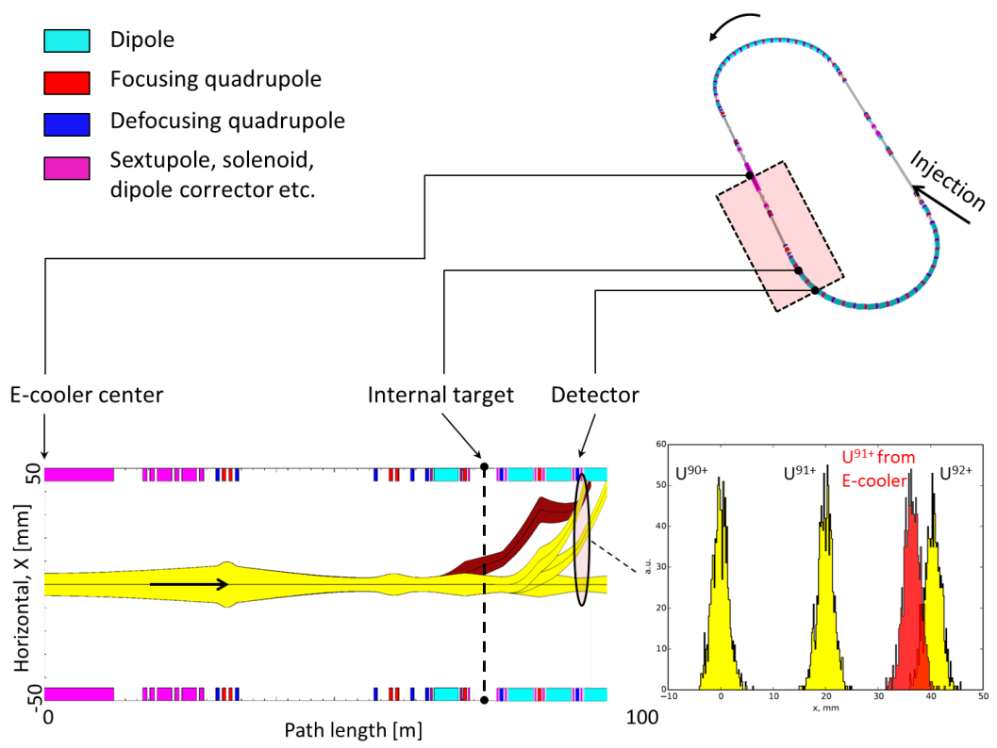
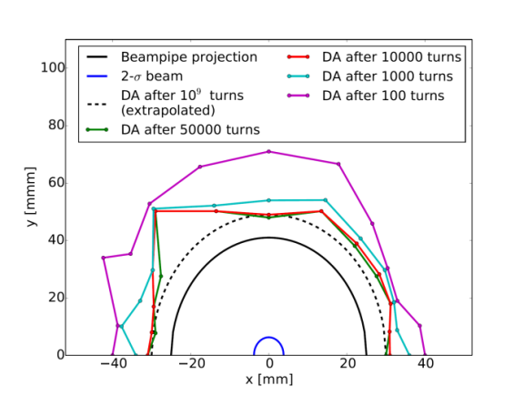
HESR Ion Optics for the Heavy Ion Operation
HESR optics functions
(O. Kovalenko et al., Phys. Scripta T (2015) in press)
Resolution of HESR:
Separation of uranium charge states behind the target
O. Kovalenko et al., Phys. Scripta T (2015) in press
APPA
Increased acceptance: 22.5 mm mrad in both planes
Enhanced dynamic aperture - 15.6 beam σ.
Charge state separation is possible
±5 mm bump at the target is possible
Reduced chromaticity
Tunes Q_{x}/Q_{y} = 5.81/5.82 (Figure below)
Dynamic aperture computations:
Normal and skew field errors up to 20th order
Normally distributed misalignments, cut at 3σ
Fringe fields included
(O. Kovalenko et al., GSI Scientific Report 2013)

Slide 12
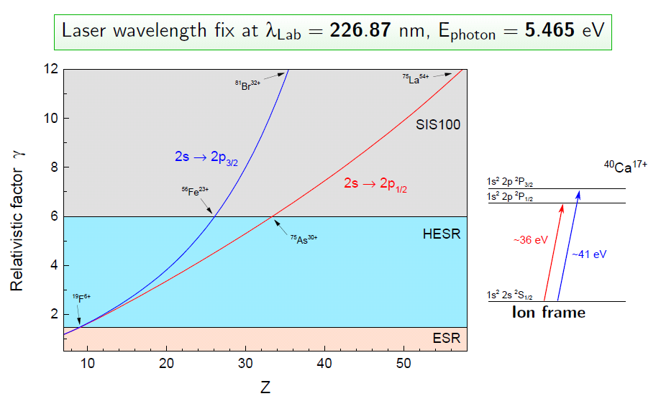
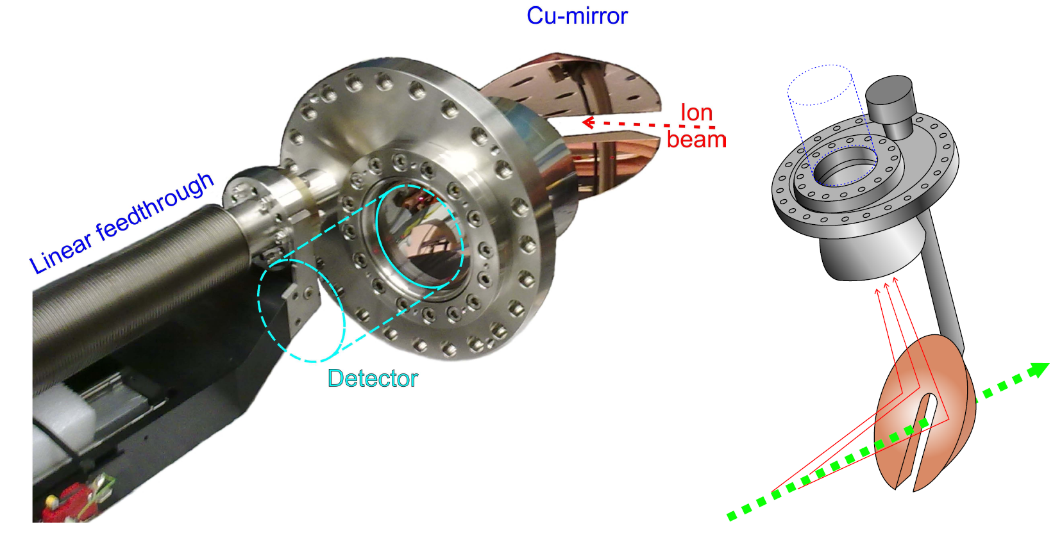
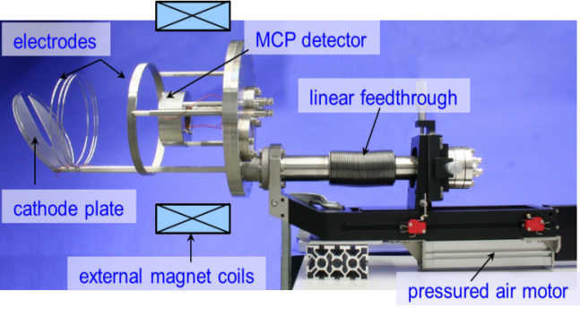
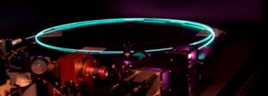
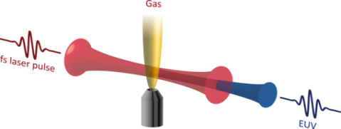
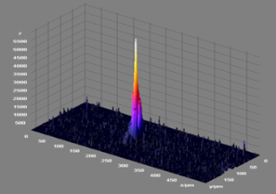
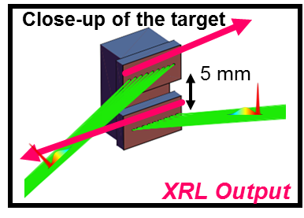
Laser Spectroscopy at HESR
Recently Commissioned: Visible
V. Hannen et al., J. Instr. 8, P09018 (2013)
High Harmonic Generation :
HIJ (Jan Rothardt), GSI
Next Generation: VUV, X-UV
University of Münster, TU Darmstadt, GSI
X-Ray laser:
GSI, HIJ (Spielmann), Paris-Sud, LOA, Lisbon, Bucuresti, Lanzhou
APPA
Detector Systems (adaptable for LASER cooling @SIS100)
Test of Bound-State Strong-Field QED
Nuclear Parameters without Shielding Corrections
New Light Sources

Slide 13
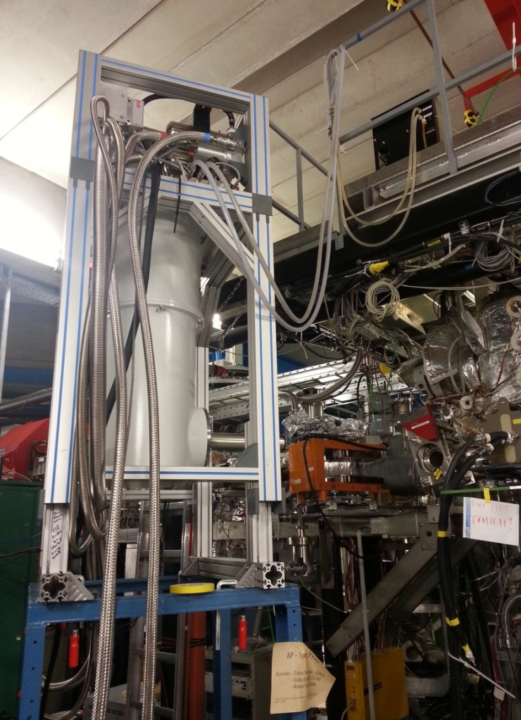
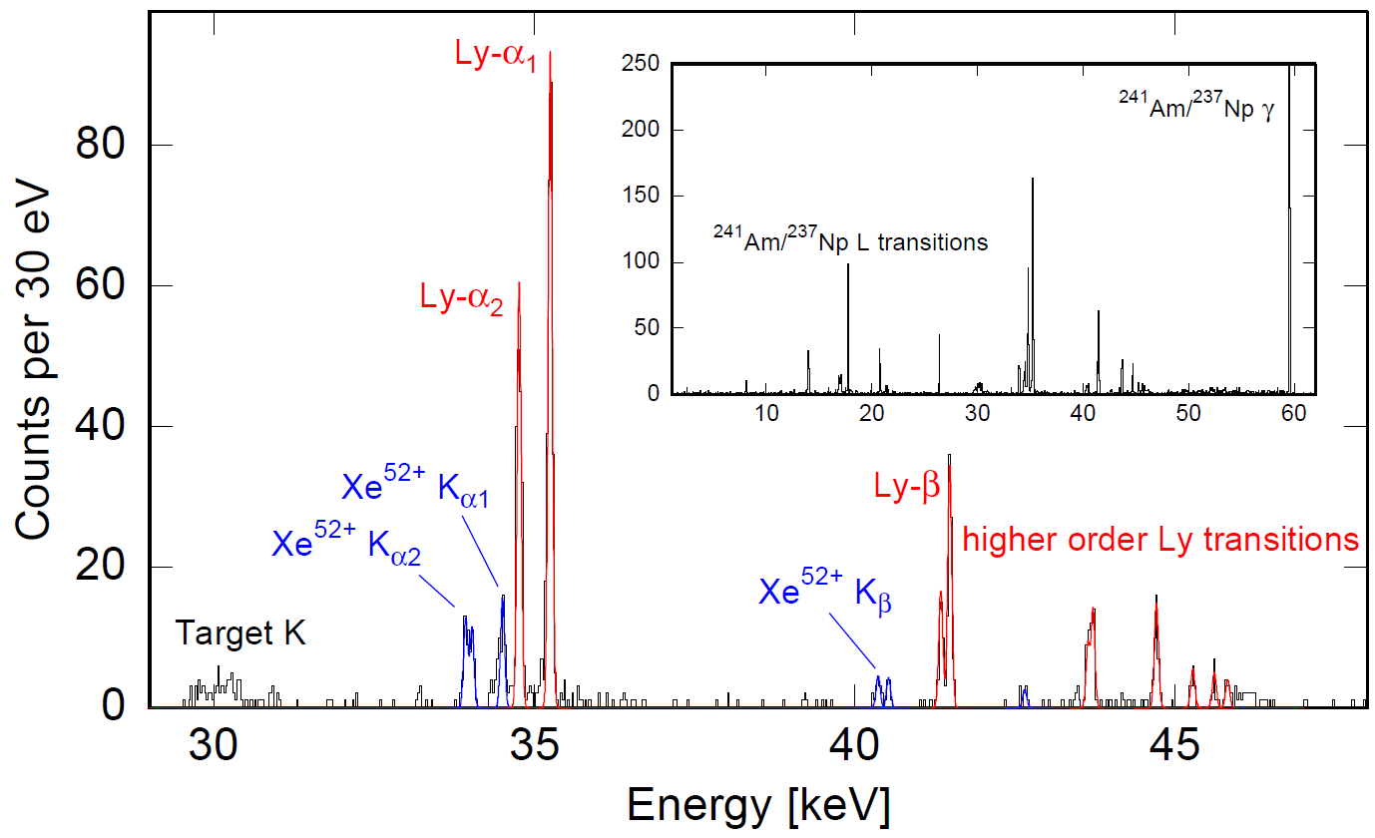
MaXs: Micro-Calorimeter Arrays for Hi-Res X-Ray Spectroscopy
Performance test at the ESR internal target
Xe⁵⁴⁺ => Xe at 50 MeV/u (August 2014)
Preliminary
APPA
Resolution of better than 60 eV at 60 keV achieved !

Slide 14
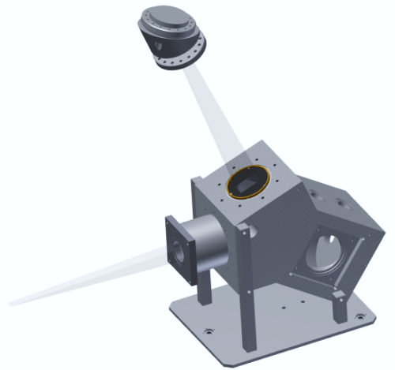
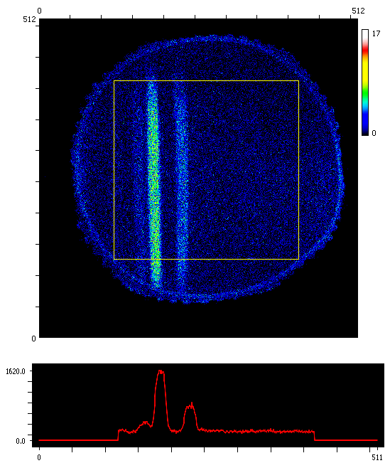
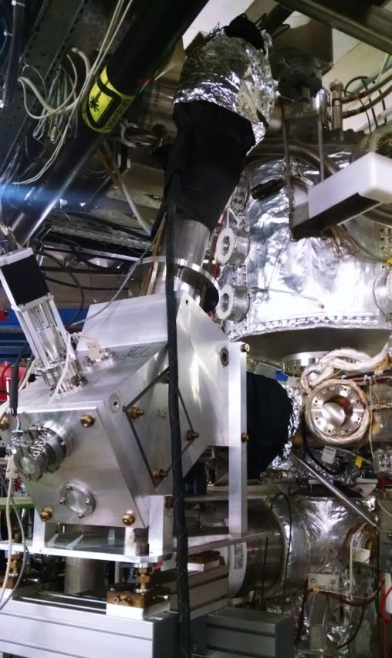
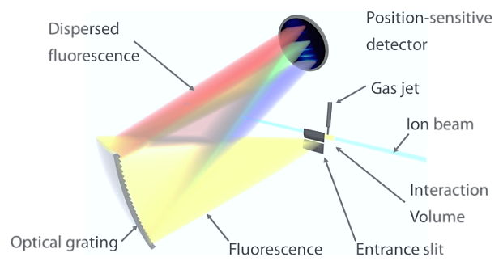
Energy Despersive Fluorescence Diagnostics at the ESR Internal Target
This experiment (August 2014):
Projectiles: Xe⁵²⁺ or Xe⁵⁴⁺ => Xe at 50MeV/u
Aim: Signal-to-noise ratio of dispersed fluorescence experiments sufficient for experiments despite very small solid angle for observation?
APPA
First spectra

Slide 15
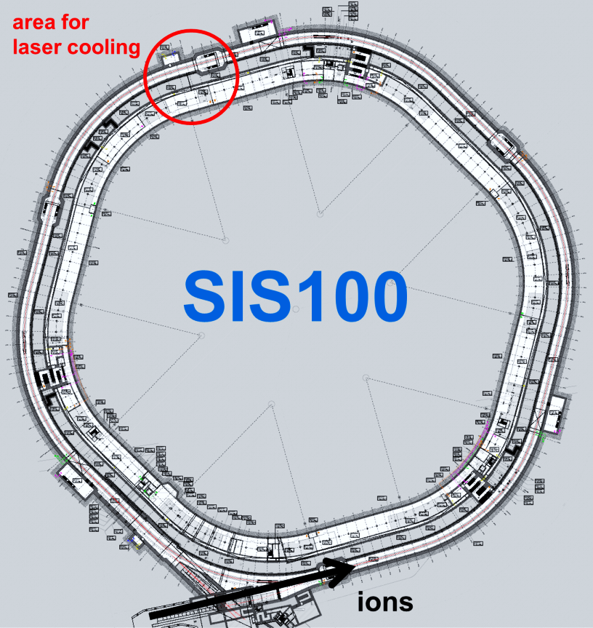
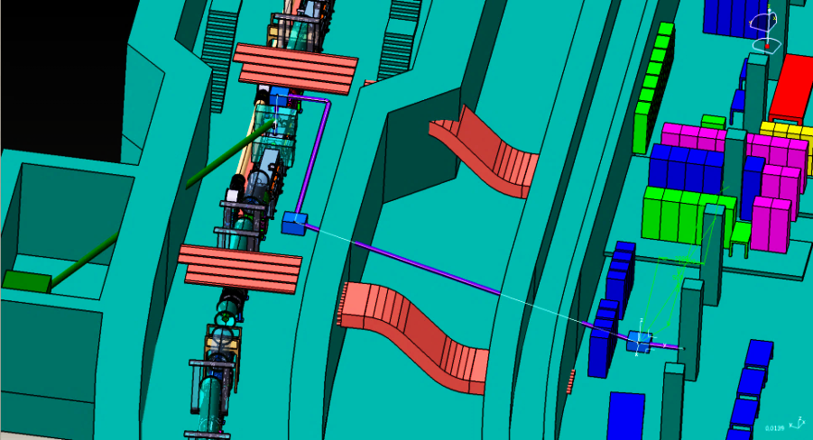
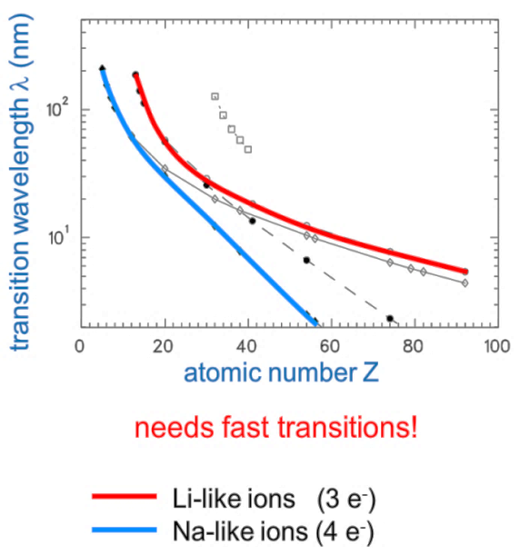
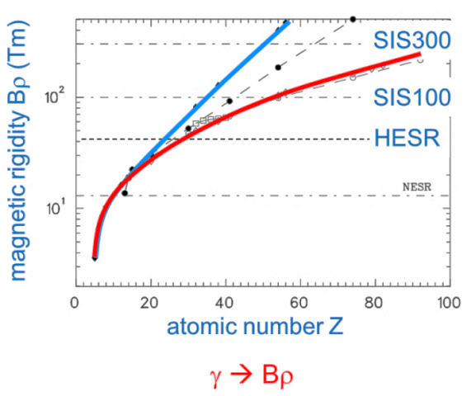
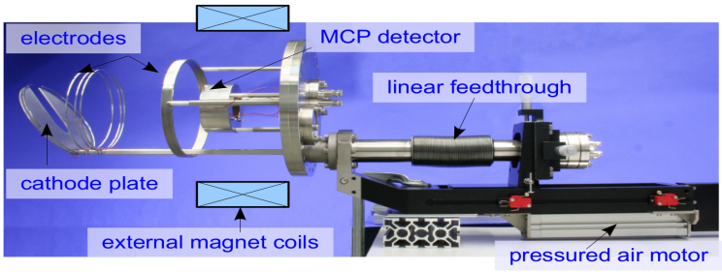
Laser Cooling at SIS100
Accelerator Tunnel (left) and Laser Lab (right)
APPA
Detector for XUV light, see p.12

Slide 16
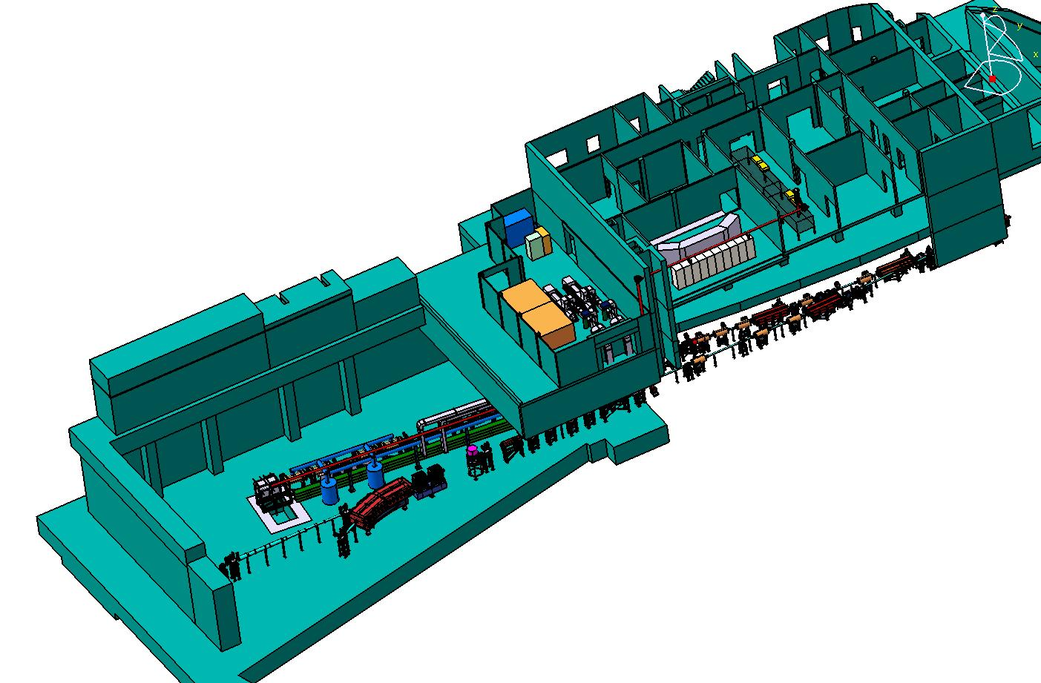
Atomic Physics Experiments at APPA-Cave
Topic: Atomic and nuclear spectroscopy on relativistic, few-electron heavy ions (HCI)
Method: Indirectly, high resolution spectroscopic investigation of HCI by means of resonant coherent excitation of relativistic few-electron ions in crystals
APPA
SPARC Setup
International collaboration: France, Germany, Japan, Romania

Slide 17
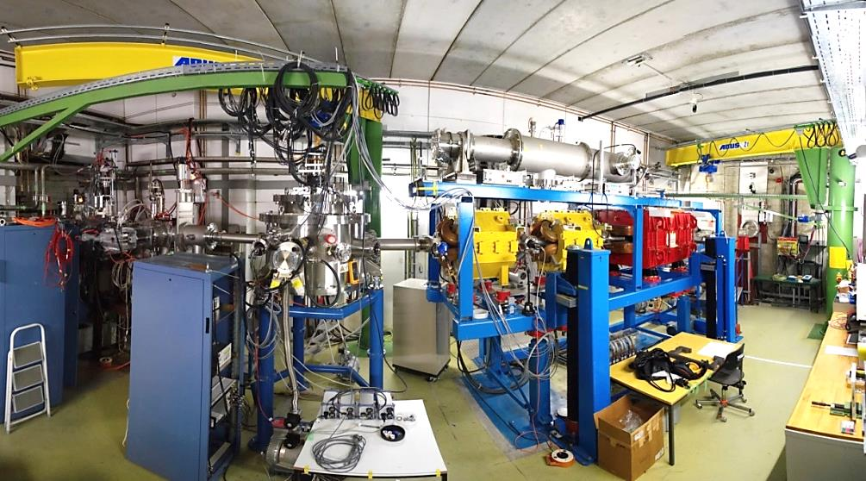
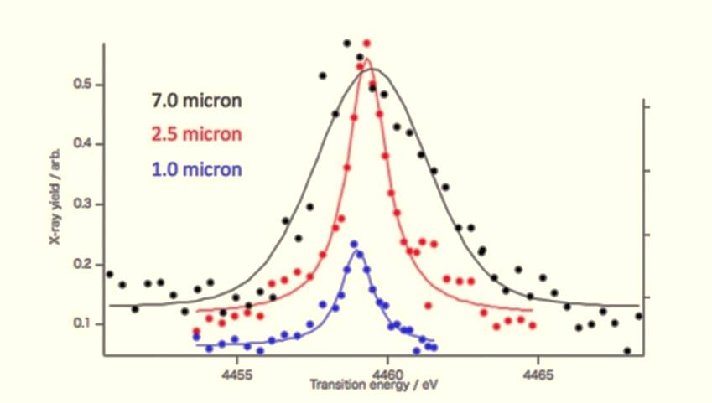
Atomic Physics Experiments at APPA-Cave
Setup: Main parts installed and commissioned at GSI with SIS18 and ESR ion beams;
Vacuum chamber with high precision 5 - axes goniometer, photon and particle detectors
Steady improvements on the beam quality through:
Cooled ion beams from ESR
Upgrade of the transfer beam line
ESR- Cave A
New beam diagnosis (CUPID): Hard and software with excellent capabilities
E_{γ}= 4.459 keV
Present Experiment:
Measurement of the 2p_{3/2} → 2s (E_{γ}=4.459 keV)
atomic transition in Li-like Uranium ions,
at 200 MeV/u using thin silicon crystals as target
APPA
FWHM = 4.3953 eV
FWHM = 1.6056 eV
FWHM = 1.3135 eV

Slide 18
BioMat Detectors
Mats

Slide 19
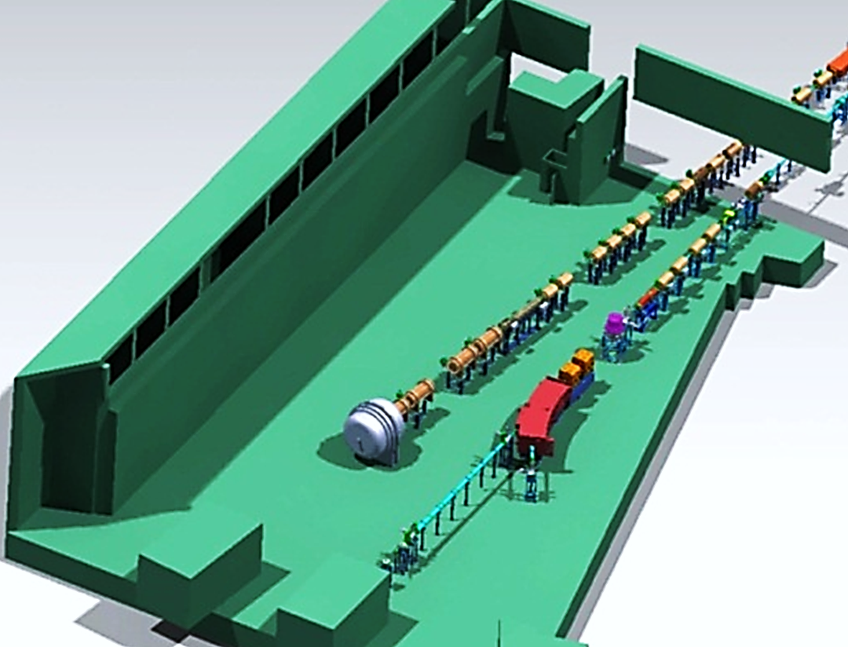
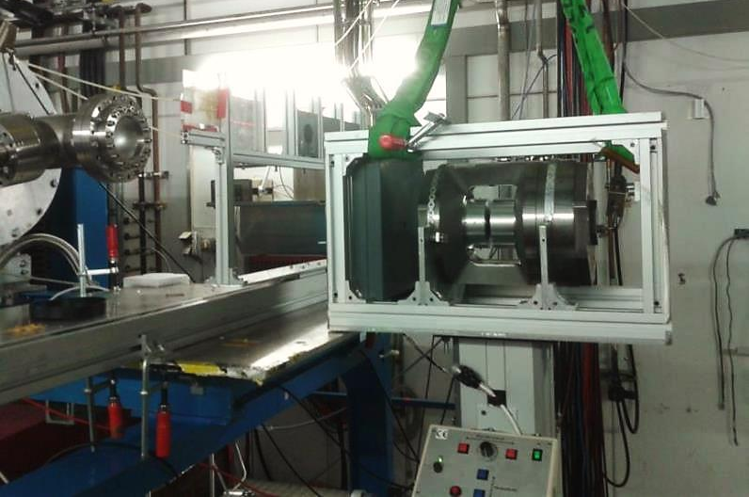
BioMat Facilities
Beamtime 2014 at SIS (Cave A)
Successful test of
large multi-anvil pressure cell
BIOMAT beamline in APPA cave
BioMat

Slide 20
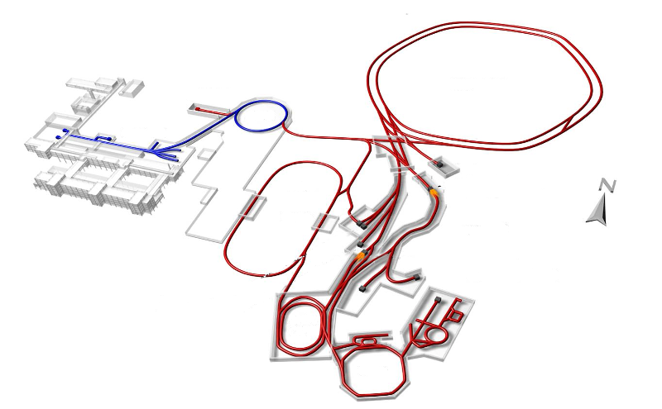
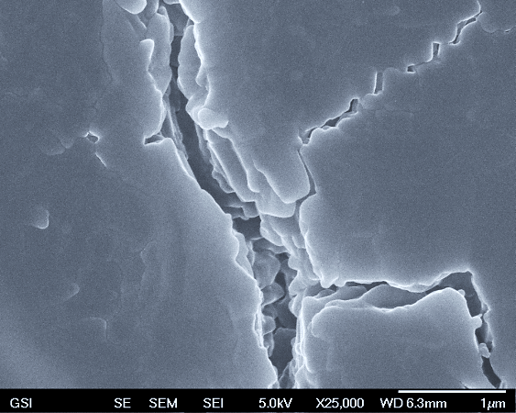
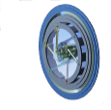
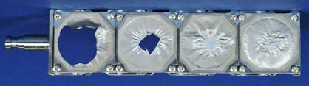
Radiation-Hardness Tests of FAIR Components
2014 Beamtime Campaign
Further high-dose exposed FAIR components
Magnet insulation
Electronic boards
Diagnostic screens
Beam dumps
Beam windows
Foil strippers for UNILAC upgrade
BioMat
Super-FRS production target

Slide 21
CBM Detector
Mats

Slide 22
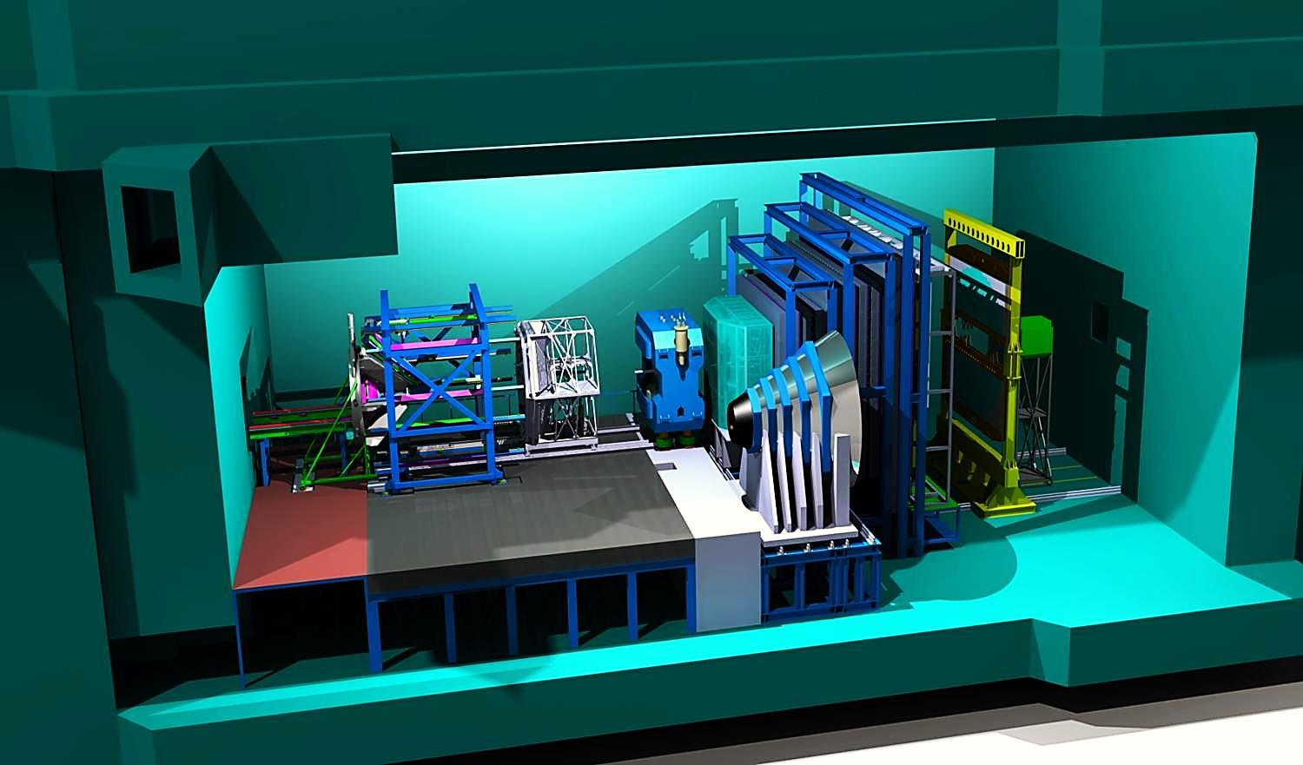
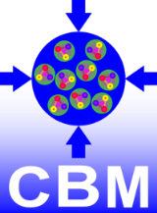

The CBM Cave
Magnet + STS RICH TRD TOF PSD
+ MVD
Beam
MUCH
Parking Position
CBM

Slide 23
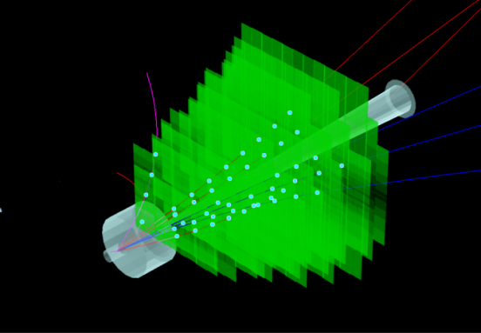
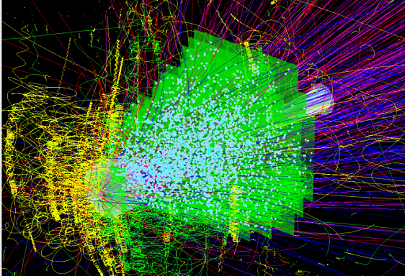
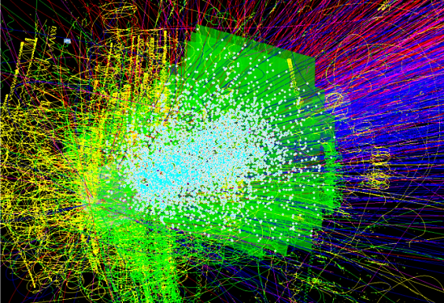
CBM Silicon Tracking System (STS)
Central detector of the CBM experiment:
Track and momentum measurement in heavy-ion collisions with up to 1000 charged particles, at interaction rates of up to 10 million per second
International high technology project:
Germany – Poland – Russia – Ukraine
Technical challenges:
High acceptance, low mass, high track density, high rate, high momentum resolution, fast read-out, radiation hard sensors, cooling, high integration density
Cost:
In 2009 11.5 M€, included are 5.4 M€ PMA money
CBM
UrQMD + GEANT + CbmRoot
p+C, 30 GeV
few charged particle tracks
Au + Au, 8 AGeV
~350 charged particle tracks
Au + Au, 25 AGeV
~700 charged particle tracks

Slide 24
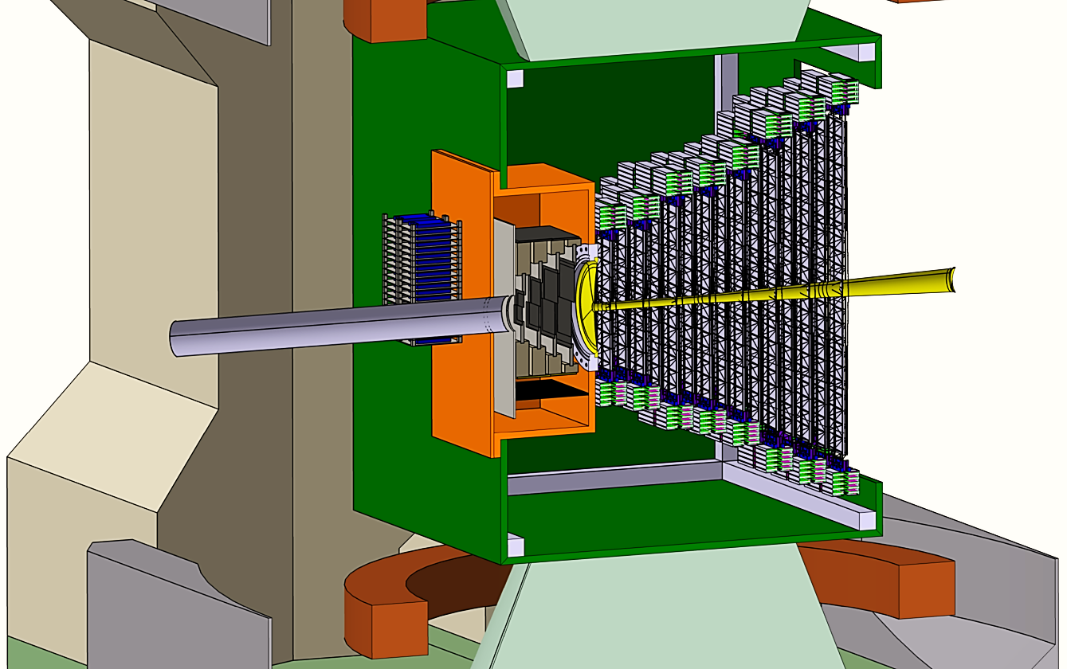
STS system concept
8 stations
appperture 2.5° < Θ < 25°
4 m² detector area
2 m³ volume
106 ladders
1040 modules
1300 silicon detectors
17 thousand ASICs
2080 circuit boards
2 million read-out channels
ca. 45 kW power dicipated
STS
MVD
beam
2.5°
25°
CBM
Target
> 100 000 single components

Slide 25
CBM - STS work packages @ GSI
CBM Silicon Tracking System (STS)
STS Project Coordination / CBM Collabor.
STS Sensors
STS Micro Cables
STS Front-End Electronics Boards
STS Modules
STS Ladders
STS Half-Stations
STS System Integration
STS HV & LV
STS Thermal Enclosure
STS Cooling
STS Software Integration
Team:
Dpt. CBM-Forschung
Dpt. CBM-Detectors
Dpt. Detektorlabor
Dpt. EE
CBM

Slide 26
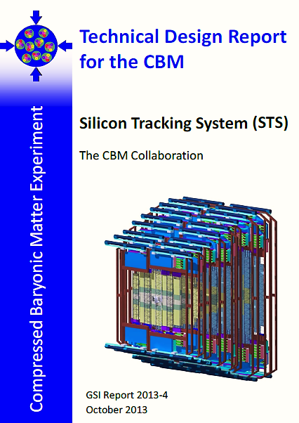
CBM - STS technical design report
submitted 12/2012
approved 08/2013
published 10/2013
CBM-STS project team:
Participants from 15 institutions in Germany, Poland, Russia und der Ukraine
CBM
http://repository.gsi.de/record/54798

Slide 27
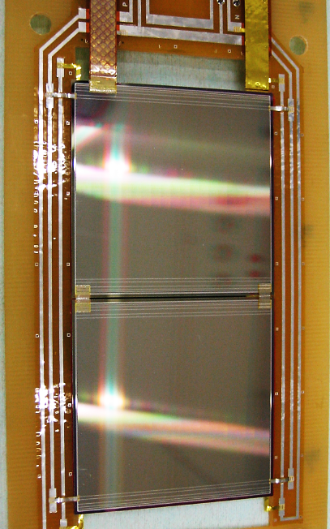

Silicon – microstrip - sensor
Ca. 300 µm thick, n-type silicon
Double-sided segmentation
1024 strips of 58 µm pitch
Strip length 6.2/4.2/2.2 cm
Angle front/back: 7.5 deg
Reead-out from top edge
Rad. tol. up to 10¹⁴ n_{eq}/cm²
6.2 × 6.2 cm²
6.2 × 4.2 cm²
6.2 × 2.2 cm²
Prototype sensors from CiS, (Germany) and Hamamatsu Photonics (Japan)
CBM
Prototype read-out sector with two daisy-chained sensors
Most recent: CBM06 (2014)

Slide 28





Micro cable
cable layers:
0.11% X0 thin
signal layers:
64 Al lines,116 µm pitch
10 µm thick
auf 14 µm polyamid
length up to 55 cm
Tab-bonding technology
CBM
signal and spacer layers

Slide 29



Free - Streaming Read - Out Electronics
STS-XYTER ASIC Front-End Board Read-Out Board
Data Processing Board
time-slicing
FLES farm
online event computing
v1.0 produced
(v2.0 under design)
UMC 180 nm CMOS
channels | 128, polarity +/-
noise | 900 e⁻ at 30 pF load
ADC range | 16 fC, 5 bit
clock | 250 MHz
power | < 10 mW/channel
timestamp | < 5 ns resolution
out interface | 4(5) × 500 Mbit/s LVDS
CBM
time-stamped data
data combining
8 STS-XYTER chips
1/2/5 LVDS links out
  GBTx chip-set (CERN):
  3 GBTx, 1 VTRx, 1 VTTx, 1 SCA
  42 E-links à 320 Mb/s
  3 GBT optical uplinks à 4.48 Gb/s
Prototype FEBs under development
(GSI in EU-FP7 HadronPhysics3)

Slide 30


Module production
Processing and tools under development
GSI
JINR
LTU Ltd, Ukraine
KIT, Karlsruhe
CBM

Slide 31



Carbon fiber ladders
CBM

Slide 32





System engineering - cabling- cooling
electronics box,
200 W,
backplane cooling
Bi-phase CO₂ cooling system
STS electronics total: 42 kW
CBM
Prototype TRAXI XL
(GSI-CERN in EU-FP7 CRISP)

Slide 33





In beam testing of STS prototype
Low-mass STS module
Silicon microstrip sensors
  Double-sided, 300 µm thick
  1024 strips of 58 µm pitch
  Front/back side strips, 7.5 deg angle
  Radiation tolerant up to 10¹⁴ n/cm²
Micro r/o cables (partial read-out)
Self-triggering electronics
Proton beam, COSY (Jülich)
Results
signal amplitudes
cluster sizes
spatial resolution
CBM
preliminary

Slide 34
NUSTAR Detectors
Mats
MATS
LaSpec
R³B
HISPEC/DESPEC
ILIMA

Slide 35





































































The NUSTAR Collaboration
> 800 Collaborators
37 Countries
NUSTAR
ENNA
146 Universities
and Institutes
35

Slide 36






Stopping Cell for the LEB of the Super -FRS
Successfull on-line test of the prototype of the cryogenic stopping cell at the FRS Ion Catcher 2011/2012
Excellent performance achieved:
Stopping gas areal density: 5 mg/cm²
Extraction efficiency: 50%
Extraction times: 25 ms
Test of rate capability
October 2014
Cryogenic stopping cell
Multiple-reflection TOF-MS
Beam
from FRS
Collaboration
Specifications (PSP 2.4.11.2.x) and contract with Finland in preparation
JLU Gießen application for BMBF-Verbundforschung 2015-2018
for FAIR Core Invest to be submitted
TDR (PSP 1.2.1.2) in preparation (to be submitted spring 2015)
Design is based on novel concept with vertical ion extraction:
- Enables unprecedented rate capability
and areal density (20 to 40 mg/cm²)
- Removes performance bottleneck of present stopping cells
NUSTAR
Notes:
36
1

Slide 37
R3B Group in the RIB Project Area
The focus of the R3B⁽¹⁾ group in the RIB project area⁽²⁾ is construction, commissioning and maintenance of:
The new large acceptance dipole magnet GLAD ⁽³⁾
The new large-area neutron detector NeuLAND ⁽⁴⁾
The new time-of-flight detector TOF13 ⁽⁵⁾
A sophisticated data acquisition system ^{(6).}
These components represent mandatory part of the R3B experimental setup at the NUSTAR facility
(1) https://www.gsi.de/rbrb
(2) https://www.gsi.de/work/rib
(3) https://www.gsi.de/work/fairgsi/rare_isotope_beams/r3b/glad.htm
(4) https://www.gsi.de/work/fairgsi/rare_isotope_beams/r3b/neuland.htm
(5) https://www.gsi.de/en/work/fairgsi/rare_isotope_beams/r3b/tof13.htm
(6) https://www.gsi.de/work/fairgsi/rare_isotope_beams/r3b/daq.htm
NUSTAR
Notes:
37
1

Slide 38

Large - Acceptance Superconducting Dipole Magnet GLAD
Magnet parameters:
Large vertical gap ± 80 mrad
High integrated field of 4.5 Tm
Fringe field at the target position less than 20 mT
Operational temperature 4.6 K
The overall size of the conical cryostat: 3.5m long, 3.8 m high and 7 m wide
Magnet financing:
Cryocomplex for the test bench of the GLAD magnet (475 k€) financed via structural BMBF funds
Completion of GLAD (cryostat) (1.8 M€) PMA
financed
Vacuum-chamber (190 k€) PMA financed
Power supply (190 k€) PMA financed
NUSTAR
Technical drawing of the GLAD magnet
Cold mass built at the CEA Saclay (France)
Notes:
38
1

Slide 39


GLAD Magnet - Production Started
Magnet has been designed and built at CEA / Saclay (France)
Cold-mass tests has been successfully ended at CEA / Saclay in December 2013
Coil tests successful: nominal current of 3584 A reached on 05.12.2013
Cold mass has been successfully integrated into the lower half of its cryostat in June 2014
In September 2014 coils have been installed. The installation of the inner vacuum chamber
will be finished November 2014.
Magnet shall be delivered to GSI Q1/2015
NUSTAR
GLAD magnet with integrated cold mass
GLAD magnet with integrated coils
Notes:
39
1

Slide 40



GLAD Cryosystem - ProductionCompleted
Cryoplant - container containing compressor and helium buffer tank, installed at the GSI site in May 2013
UNICOS sample system for controlling the GLAD cryo-system has been installed in April 2014
The compressor of the R3B cryo plant with the new UNICOS control system has been successfully tested (June 2014)
Test with turbines will be
done November 2014
NUSTAR
UNICOS control unit
Layout of the UNICOS controls
Notes:
40
1

Slide 41

GLAD Power Supply - Production Started
Detailed specifications have been approved
by CEA
The power supply system built by the
Jäger company
Delivery Q4/2014
NUSTAR
Notes:
41
1

Slide 42

GLAD - Vacuum Chamber
Specifications ok
Cost estimate 190 k€
Tendering closed on 02.12.2013
Chamber built by the VA-TEC company
FAT 05.11.2014
Delivery to GSI Q4/2014
NUSTAR
GLAD magnet with its vacuum chamber

Slide 43

High-Resolution Neutron Time-of-Flight Spectrometer NeuLAND
Performance goals:
>90% efficiency for 0.2-1 GeV neutrons
Multi-hit capability for up to 5 neutrons
<150 ps time resolution
20 keV excitation-energy resolution at 100 keV
above neutron threshold
Detector parameters:
Full active detector using organic scintillator
Face size 250 x 250 cm², active depth 300 cm
3000 scintillator bars
6000 photomultiplier and readout channels
Modular design
Detector financing:
20% demonstrator (1020 k€) already financed by BMBF and PMA; demonstrator ready by Q1/2014
Upgrade to 45% detector (1180 k€) will be financed by secured funds of BMBF and PMA plus proposed In-kind contribution by PNPI (Russia, 03.06.2013); 45 % detector ready by Q4/2015
High Voltage system (527k €) proposed as In-kind contribution by PNPI (Russia, 03.06.2013)
NeuLAND mechanics and infrastructure (248 k€) financed through PMA
NUSTAR
NeuLAND Technical Design Report has been approved on Jan. 18th, 2013 by FAIR
Notes:
43
1

Slide 44

NeuLAND Scintillator Bars - Production Completed
Full detector contains 3000 scintillator bars arranged in 30 double planes
In July 2013 the first double-plane has been built. In November 2013, 2nd and 3rd double
planes have also been built. 4th plane has been built in January 2014
5th and 6th in September-November 2014
NeuLAND Technical Design Report has been approved on January 18th, 2013 by FAIR
First NeuLAND double plane built at GSI
NUSTAR
Photomultipliers:
For the full-size detector 6000 PMs are needed. Frame contract signed with HAMAMTSU. First charge of PMs has been delivered to GSI in September 2013.
Notes:
44
1

Slide 45


NeuLAND HV System - Production Started
For the full size detector 6000 HV channels are needed. HV system is based on 2kV main supply with controllable dividers
Solution proposed by PNPI (Russia) was accepted by the FAIR council as In-kind contribution. Collaboration Contract on „The production and delivery of the High Voltage Distribution System for the NeuLAND detector and the development of the EPICS IOC application software“ signed in July 2014
The pre-series (200 channels) will be delivered up to end of this year
Two attenuator boards
100 ch
NUSTAR
HV connected
via pcb+ connectors
The high voltage distribution boards have arrived at GSI in October 2013.
The boards will allow to distribute the HV to each PM and collect the signal cables at the same time.
Notes:
45
1

Slide 46
NeuLAND Electronics - Production Started
In-house solution from the GSI CSEE group. Based on the Tacquila system which has been tested during S406 experiment in October 2012
NUSTAR
Fully Integrated System: Precision timing, energy, trigger, monitor
With this system, a time resolution of 114 ps has been obtained during the test experiment S406
Notes:
46
1

Slide 47
NeuLAND Electronics - Production Started
Ongoing improvements: A new multichannel front-end electronic card TAMEX for high-resolution time and charge measurements has been designed by the GSI CSEE group and delivered
The card is a combination of the existing LAND TACQUILA FEE and a FPGA TDC from the VFTX module
It has been tested during the second run of the S438 experiment (October 2014)
NUSTAR
Notes:
47
1

Slide 48



NeuLAND Mechanics - Production Started
Mounting rack to be used for the assembly of double planes has been built and installed
It can also serve as a mid-term frame for the 20% NeuLAND demonstrator
Electronic boxes
Cable boxes
NUSTAR
Double plane
HV distribution boxes
Notes:
48
1

Slide 49

NeuLAND Mechanics - Procurement in Preparation
Full-detector frame and integration are in the design phase; delivery during 2015
NUSTAR
Full-detector frame containing 30 double planes and corresponding infrastructure
(electronic-, cable- and HV distribution boxes)
Notes:
49
1

Slide 50

NeuLAND - Detector Tests
Preliminary analysis of the S438 data (April run, 2014) has resulted in a 100 ps time resolution for the gamma peak
Measurements have been performed using 700 AMeV ⁵⁸Ni beam and a Pb target. In the same time, using the charge-particle veto x- and y-position of the neutrons impinging
in the NeuLAND prototype, see figure below, have been obtained
NUSTAR
Hit positions of neutrons impinging on the NeuLAND detector
Notes:
50
1

Slide 51
NeuLAND Simulations
Simulations have been performed using FairRoot simulation package
Excellent agreement between simulation and experimental data measured during the S406 experiment has been obtained
Energy per NeuLAND paddle
Neutron-multiplicity distribution
NUSTAR
Notes:
51
1

Slide 52

Time - of - Flight Detector TOF13
Performance goals:
Time resolution σ_{t}/t = 2E-4 (⇔ σ_{t} =20 ps for 20 m flight path at 1 AGeV)
Energy resolution σ_{E} /E = 1%
High-counting rate capabilities
All this also for the heaviest available ions (Pb-U)
Detector parameters:
Four layers of organic scintillator (EJ204) paddles
44 paddles pro layer
Active area 1200 x 800 mm²
352 photomultiplier (R8619 with fully active base)
and 352 readout channels (TAMEX or PADI)
Modular design
Detector costs:
Mechanics: 10 k€
Scintillators: 40 k€
Photomultipliers: 72 k€
Electronics: 35 k€
High voltage: 35 k€
NUSTAR
TDR ready to be submitted as a part of the R3B tracking TDR
Notes:
52
1

Slide 53

TOF13 - Production Started
Detector prototype (April 2014)
Two layers of scintillator paddles of 3 mm thickness, followed by two layers of paddles with 5 mm thickness. Each layer consists of 6 paddles
Each paddle was directly coupled to a R8619 PM with fully active base from Hamamatsu
For testing purposes, PADI electronic cards and a prototype of the TAMEX card has been used
Prototype detector has been tested during S438
NUSTAR
Notes:
53
1

Slide 54


TOF13 - Prototype Results: Time Resolution
Analysis of the April run of the S438 experiment has shown that the TOF13 detector fulfill design goal of σ_{t}/t = 2E-4
⁵⁸Ni at 500 AMeV
Measured time resolution:
NUSTAR
Between two paddles
Of the whole detector
TOF between two paddles at different rates
Notes:
54
1

Slide 55



TOF13 - Prototype Results: Nuclear - Charge Resolution
Analysis of the April run of the S438 experiment has shown that the TOF13 detector fulfill design goal: σ_{Z} /Z < 1%
⁵⁸Ni at 500 AMeV
NUSTAR
Nuclear charge measured at different rates
Notes:
55
1

Slide 56

TOF13 Mechanics - Procurement in Preparation
Modular design: Each TOF13 frame holds a double plane of scintillator paddles Additional frames in front containing beam-tracking detectors
All frames can be combined to form a light-tight housing
NUSTAR
Notes:
56
1

Slide 57


TOF13 Simulations - Time resolution
⁵⁸Ni at 500 AMeV
Measured:
14 ps
Simulations in agreement with experiment
Show that we can reach needed resolution also with 208Pb at 1AGeV
Show that strongest contribution comes from electronics → No need for expensive PMs!
All
Scintillator
PM
Electronics
NUSTAR
Notes:
57
1

Slide 58

DAQ - Completed Production
Distributed Prototype DAQ system with ‘foreign’ systems including trigger and timestamp distribution (several 100 m) was successfully tested
Components
& software are
readily available
NUSTAR
Notes:
58
1

Slide 59

DAQ - Started Production
First new multichannel front-end electronic card TAMEX for high-resolution time and charge measurements have been equipped with electronic components and tested during S438 experiment with NeuLAND and TOF13 detectors
Charge measurements have been benchmarked using a novel QTC board which has been integrated as option for the TAMEX readout, time over threshold methods and a QDC
NUSTAR
Notes:
59
1

Slide 60


HISPEC Phase 0 Successfully used for Physics Campaign
The fully functional set-up has been commissioned in 2012 and employed until April 2014 for gamma spectroscopy experiments at the FRS at GSI
NUSTAR
First implementation of FAIR/NUSTAR/HISPEC
Notes:
60
1

Slide 61


DESPEC – DEGAS TDR Submitted
Following extensive R&D work a TDR for the first two phases of DEGAS has been written and submitted to FAIR in August
DEGAS will be a highly sensitive gamma array for decay spectroscopy together with the implantation array AIDA. DEGAS is the core device of DESPEC and will be realized in three phases:
Phase I: 26 Triple EUROBALL Cluster Ge detectors reconfigured from RISING
Phase II: Complementing phase I detectors by AGATA type clusters
Phase III: Further development into a full imaging array
NUSTAR
Designed for a full energy efficiency >20% DEGAS will even surpass the RISING array which holds the world record in efficiency and sensitivity for decay experiments!
Notes:
61
1

Slide 62

DESPEC – DEGAS EDAQ Evaluation
Currently several options for the data acquisition of DEGAS phase I are under evaluation. A FEBEX based system has already proven to fullfill the basic requirements. Other options to be checked are commercial digitizers and the new AGATA electronics.
NUSTAR
AGATA – DIGIOPT12 module
FEBEX system for DEGAS Phase I
Notes:
62
1

Slide 63





TOF Detector Test Bench
Electron Transport efficiency x2
(B. Fabian PhD Thesis, University Gießen, 2008)
Larger turn number possible (x10)
(GSI Scientific Report 2010, p.141)
Better timing accuracy (σ_{Timing}: 45 ps → 38 ps)
(N. Kuzminchuk PhD Thesis, University Gießen, 2011)
MCP signal shape improved by anode shape;
width x0.5 (GSI Scientific Report 2010, p.141)
Position dependent test with
α-source or laser pulses
at Univ. Giessen
e
-
Si detector (optional)
MCP Forward
Carbon foil
MCP Backward
NUSTAR
Aperture
e
-
source
241
Am
DSO
Software data
analysis
Now testing with 80mm diameter carbon foils from TU Munich

Slide 64



TOF Detector System for CR
2 detectors
for velocity measurement
CR
(two detectors)
Foil diameter 80 mm
Dimensions: 562 mm x 180 mm x 236 mm
Electron transport efficiency ≈ 98%
Timing accuracy ≈ 35 ps
Active area x 4 required, new design only, scaling up the existing detector not possible
NUSTAR
Achievements:
Simulations for the CR and the TOF detector
(M. Diwisch PhD Thesis, University Gießen, in preparation; GSI Scientific Report 2012, p. 212)
Simulated performance of the TOF detector even
surpasses the performance parameters of the existing detector
CAD drawings exist

Slide 65
Status of the EXL⁽¹⁾ group
(1) https://www.gsi.de/work/forschung/nustarenna/kernreaktionen/activities/exl.htm
Notes:
65
1

Slide 66



First Nuclear - Reaction Experiment with stored Radioactive Beam
Unique physics goals:
⁵⁸Ni(p,p) and ⁵⁸Ni(α,α`): feasibility studies and proof of principle
⇒ UHV capability of detector setup
⁵⁶Ni(p,p): doubly magic nucleus ⁵⁶Ni:
Of high interest for structure and astrophysics
Prototype for EXL reaction setup:
Design after innovative and intense R&D
Concept: DSSD`s as active vacuum barrier between UHV and auxiliary vacuum:
B. Streicher et al., NIM A654 (2011) 604
beam
NUSTAR
Detector viewinside UHV
Notes:
66
1

Slide 67



Results of the first Nuclear - Reaction Experiment at ESR
Preliminary
⁵⁶Ni(p,p) elastic scattering @ 400 MeV/u
differential cross section
Nuclear matter distribution and matter
radius extracted for the first time
⁵⁶Ni(p,p’) inelastic scattering on first
excited level (2⁺, E=2.7) MeV
also measured
NUSTAR
⁵⁸Ni(α, α’) inelastic scattering @ 100 MeV/u
Position and the width of the giant resonances
agree with previous data ⇒ proof-of-principle
Notes:
67
1

Slide 68
Panda Detector
Mats

Slide 69
The PANDA Experiment at FAIR@GSI
The mission of the PANDA department⁽¹⁾ in the Stored Beams project area⁽²⁾ is the
coordination of the German In-Kind contributions to the PANDA experiment⁽³⁾
These include:
The design, construction, commissioning, and maintenance of the novel Barrel DIRC
Cherenkov detector
The design and test of the APFEL⁽⁴⁾ readout ASIC for the Electromagnetic Calorimeter
Liaison to FZ Jülich for the coordination of the design, test, and construction of
the Straw Tube Tracker and the Micro Vertex Detector via cooperation contract
(1) https://www.gsi.de/index.php?id=3343
(2) https://www.gsi.de/work/fairgsi/stored_beams.htm
(3) http://www-panda.gsi.de/
(4) https://www.gsi.de/start/forschung/wissenschaftlich_technologische_abteilungen/
experiment_elektronik/elektronik_entwicklung/asic/projekte.htm
Panda

Slide 70

The PANDA Barrel DIRC
  Particle identification detector for PANDA,
  provides pion/kaon (and proton) separation
  up to 3.5 GeV/c in the target spectrometer
  Uniquely thin and compact design, reducing
  size of PANDA solenoid and calorimeter
  Identification of charged particles with
  extreme efficiency and purity one of the
  key requirements for many aspects of the
  PANDA physics program
  German In-kind contribution to PANDA
  GSI responsible for system construction; important contribution, world-wide visibility
  Cooperation with University of Erlangen (since 2006, sensors) and University of Mainz/HIM (since 2010, electronics)
Photon detectors and electronics
240cm
100cm
Radiator bars
Focusing optics
Panda
  Current activity focus: Finalize system design and prototyping,
  completed TDR in 2016

Slide 71



The PANDA Barrel DIRC
  Compact DIRC detector design: Focusing optics and novel multi-anode photon sensors for efficient, fast detection of single photons
  Sensor candidate for PANDA Barrel DIRC identified in 2013,
  evaluation of alternate vendor (avoid sole source situation) ongoing
PANDA DIRC prototype bars
  Highly polished rectangular bars made from synthetic fused silica
  (“quartz”) produce Cherenkov light, guide photons to sensors.
  Fabrication challenging, expensive, few vendors world-wide
  Prototype program with industry partners in Europe, USA, Japan;
  ~30 bars/plates produced by 6 companies using different techniques
  Developed laser setup to measure bar properties
  (surface polish, bar angles)
  Perform quality assurance, pre-qualify vendors for tendering process.
  New optical lab at GSI for quality assurance measurements close to completion
DIRC bars in laser setup
Panda

Slide 72



The PANDA Barrel DIRC
  Progression of increasingly complex system prototypes
  → validate technology and design choices in particle
  beams at GSI and at CERN
  New prototype built and tested in 2014
Electronics Optics (prism, lens, plate)
New prototype in front of ALADIN magnet
DIRC team during 2014 test beam⁽¹⁾
Panda
(1) http://blogs.helmholtz.de/beamon/2014/09/ultraglatt-und-ultradurchsichtig/

Slide 73


The PANDA Barrel DIRC
Two beam times at GSI in 2014 (July, Aug. / Sep.)
PANDA DIRC prototype in cave C
  Primary goals:
  Test and validate potential cost-saving design improvements
  for optics (solid fused silica prism and wide fused silica plate)
  Test new compact readout electronics (PADIWA/TRB3)
  Pion beam (1.7 GeV/c)
  in cave C, parasitic to HADES
Panda
Observed Cherenkov photon pattern
Data calibration and analysis still ongoing,
preparing presentation at IEEE conference in November

Slide 74

The PANDA Barrel DIRC
Construction of new laboratory space for PANDA DIRC nearing completion
Panda

Slide 75




The PANDA Barrel DIRC
DIRC lab containers in Heckhalle (near main campus).
Moving equipment into new lab containers,
planning first measurements in November 2014
Optical lab (laser measurements)
Mechanical lab
Electronics lab
Panda

Slide 76



The PANDA EM Calorimeter: Front - End Electronics
PANDA electromagnetic calorimeter
Backplane PCB connecting eight front-end boards
Panda
Rigid – flex PCB for front end electronics
76
Notes:
Currently detector prototype tests for barrel and backword endcap at MAMI are in preparation.
First beam test in July 2014, next beam test planned for January 2015
Collaboration with University of Giessen, HIM, Orsay, Protvino

Slide 77


The PANDA EM Calorimeter: APFEL Readout ASIC
APFEL 1.5
  Integrated Preamplifier and Shaper
  for PANDA EMC
  Designed by GSI Microelectronics group
  „High tech made at GSI“
  Design is ready for production
Panda
77

Slide 78



GSI-FZJ Cooperation Contract
Straw Tube Tracker and Micro Vertex Detector partially financed via
GSI/FZJ Projektmittelantrag; will be built at FZ Jülich, delivered to GSI
Memorandum of Understanding
signed on October 1st 2014
Panda

Slide 79


GSI - FZJ Cooperation Contract
TDR approved.
Micro Vertex Detector
Panda

Slide 80

GSI - FZJ Cooperation Contract
Micro Vertex Detector
Panda

Slide 81

GSI - FZJ Cooperation Contract
Straw Tube Tracker
TDR approved
Panda

Slide 82
Plasma Physics Detectors
Mats

Slide 83

PBPP - Plasma Physics at FAIR
The scope of the PBPP group is the design and coordination of the construction of the APPA cave and the experimental setup for the plasma physics experiments at FAIR, regarding the demands of the HEDgeHOB and the WDM collaboration.
The main components are:
Matching section ion beam line with nc magnets and ion beam diagnostics
RF deflector (wobbler) with the belonging infrastructure
Large aperture sc final focusing quadrupoles
Target chamber for interaction experiments
Diagnostic tools, e.g. diagnostic laser or Proton microscopy (PRIOR) incl. separate target chamber
Plasma Physics
Notes:
83
1

Slide 84

PBPP - Matching Section Beam Line
3 separate beam lines integrated into a single one
Integrated into DMU
Ion beam diagnostics and vacuum components determined, integrated into DMU
TDR in progress
BPM / BD vacuum chamber
3x Quadrupoles Typ 10
BD Vacuum Chamber /
SEM grid / scintillation screen
BD chamber/ SEM grid + scintillation screen
Quadrupoles Typ 11
Steerer X/Y
Steerer X/Y
3x Quadrupoles Typ 2
3x Quadrupoles Typ 11
SEM grid +
scintillation
screen
Ion getter pump
Ion getter pump
Plasma Physics
Turbopumping Station

Slide 85

PBPP - RF Wobbler
Wobbler designed at ITEP
Infrastructure (Klystrons, etc.) defined to be the same as for pLinac
Integrated into APPA cave and DMU
TDR to be submitted in November 2014
Plasma Physics

Slide 86

PBPP - Large Apperture s.c. Quadrupoles
Large aperture super conducting quadrupoles for the final focusing and as imaging system for PRIOR
Designed and to be built by IHEP (Russia)
Agreement to use s.c. current leads
Solution for He-supply found by using old He-compressor of R3B
Specification for s.c. current leads to be finished 2014
TDR submitted and approved
Working on specifications for Quads
Plasma Physics

Slide 87


PBPP - Target Chamber
Conceptual design of target chamber finished
Calculation on radiation load by FAIR ion beam done
Agreement on target exchange and target positioning system
TDR submitted, first response by referee received
Plasma Physics

Slide 88



PBPP - Diagnostic Tools: Laser
Set of diagnostic tool for day one experiments defined
Conceptual design for a Diagnostic laser developed
Laser integrated into APPA cave and DMU
TDR submitted
Plasma Physics

Slide 89


PBPP - Diagnostic Tools: PRIOR
PRIOR - Proton Microscope for FAIR
Worldwide unique high-energy proton microscopy setup with SIS100 proton beam
Dynamic HEDP experiments and PaNTERA, jointly with BIOMAT collaboration:
Unparalleled density distribution measurements and Proton Therapy and Radiography (PaNTERA) project
p, 5–10 GeV, 2∙10¹², PRIOR
Construction and commissioning of prototype at HHT (SIS18)
Successfully tested
  Static experiments: Lateral resolution ~ 30 μm
  Dynamic experiments: Temporal resolution ~ 10 ns
PRIOR as density diagnostic with external driver integrated into FAIR beam line
Plasma Physics

