Slide 1
News from HI-Jena
Alexander Kessler, Dominik Hollatz, Chien Li-Lee
Helmholtz Institut Jena
CS-Workshop 2023

Slide 2
Outline
HIJ Laser Systems
New Institutes Building
Update from LabVIEW Projects
Efforts on research data managment
HMC Project HELIPORT
POLARIS Shot DB SciCat Approach
HMC Project HELPMI
Alternatives to LabVIEW?

Slide 3
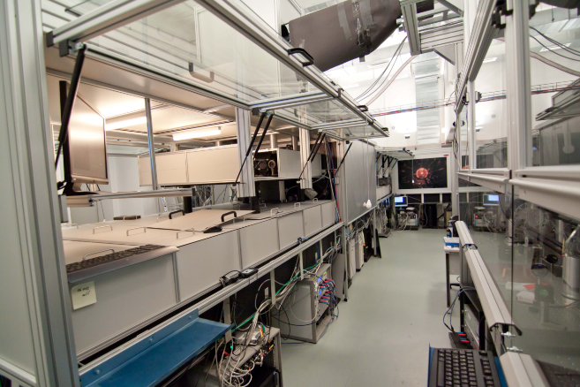
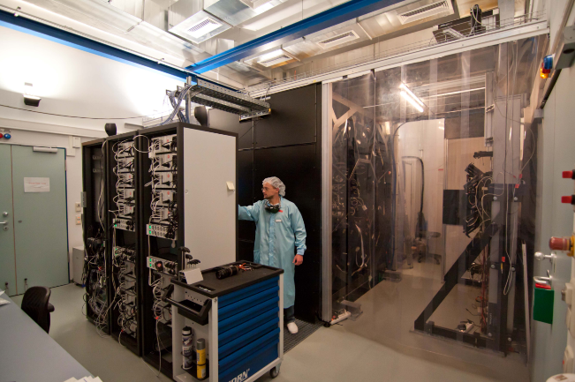
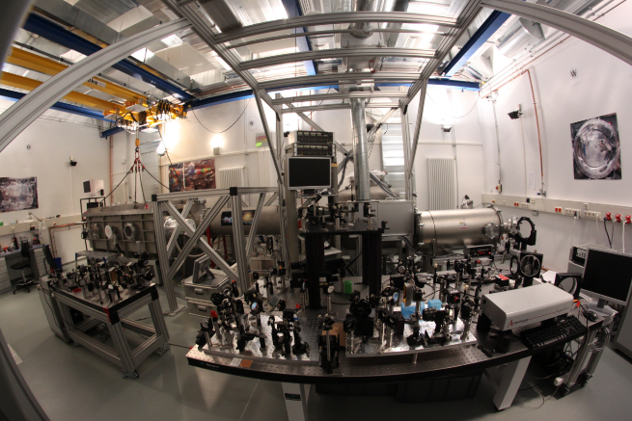
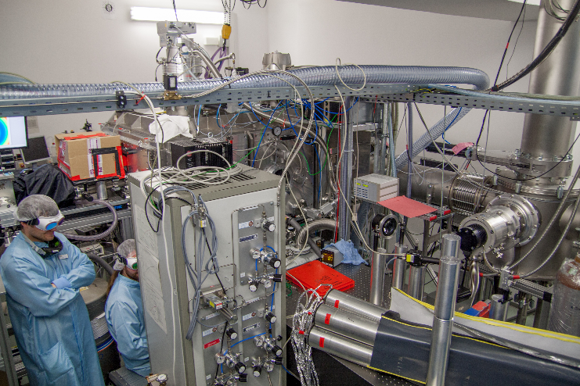
POLARIS Laser
Dubble CPA - System: Chirped Pulse Amplification
Active Stretcher in active development
Five amplifier stages
Vacuum Mosaic Grid Compressor
Lab1: Strecher and A1-A4
Lab2: A5
Lab3: Compressor & Diagnostik
Lab4: Target

Slide 4
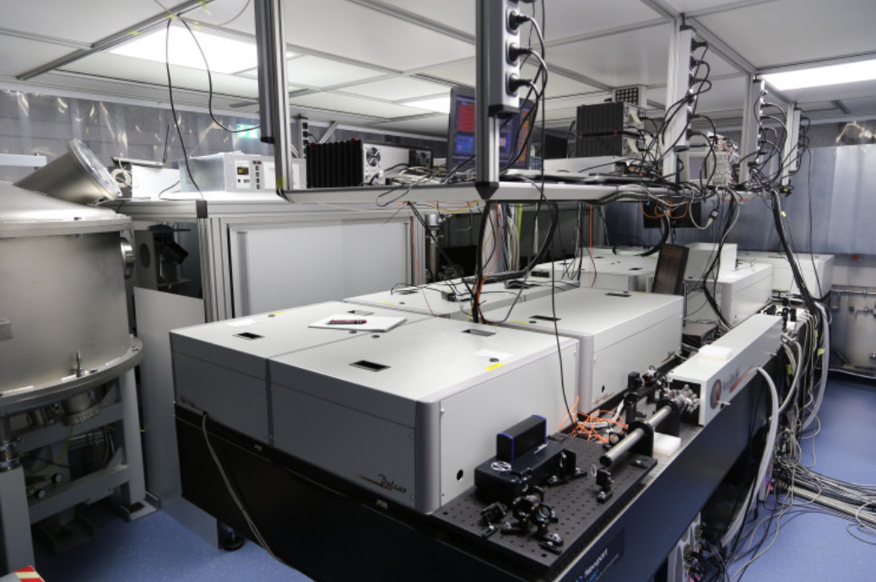
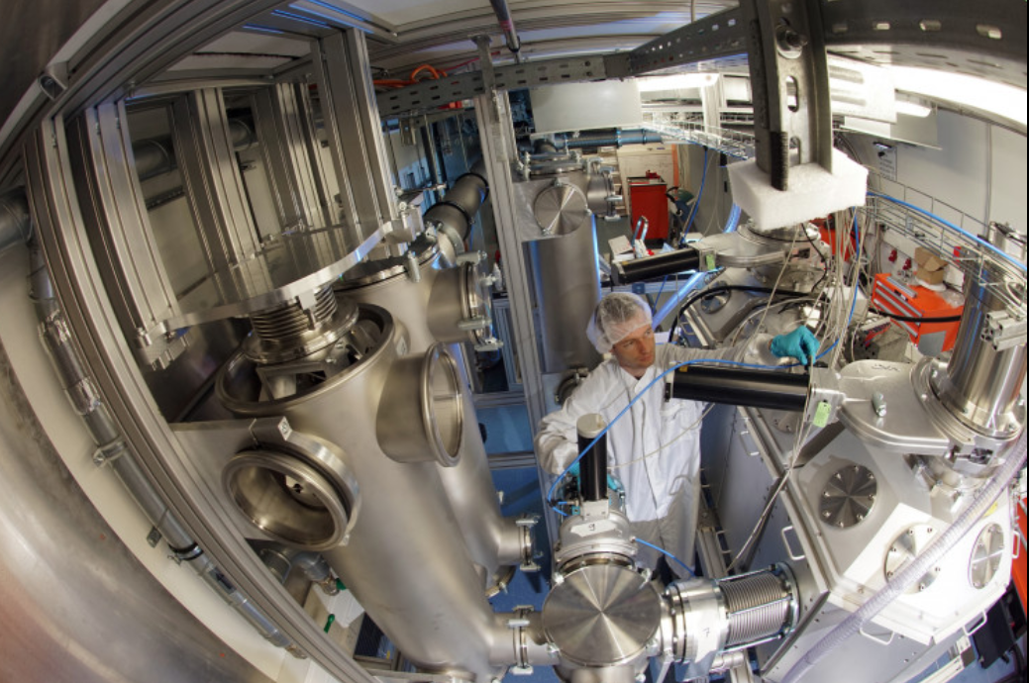
JETI200 Laser
Titanium:Sapphire-based laser system with over 200 TW peak power from Amplitude.
Energy: 4 J; Pulsduration: 17 fs; Intensity ca. 10²¹ W/cm²
How we can integrate Amplitude closed SW into higher-level control system?
If ordering from Amplitude, still open the warranty question?

Slide 5
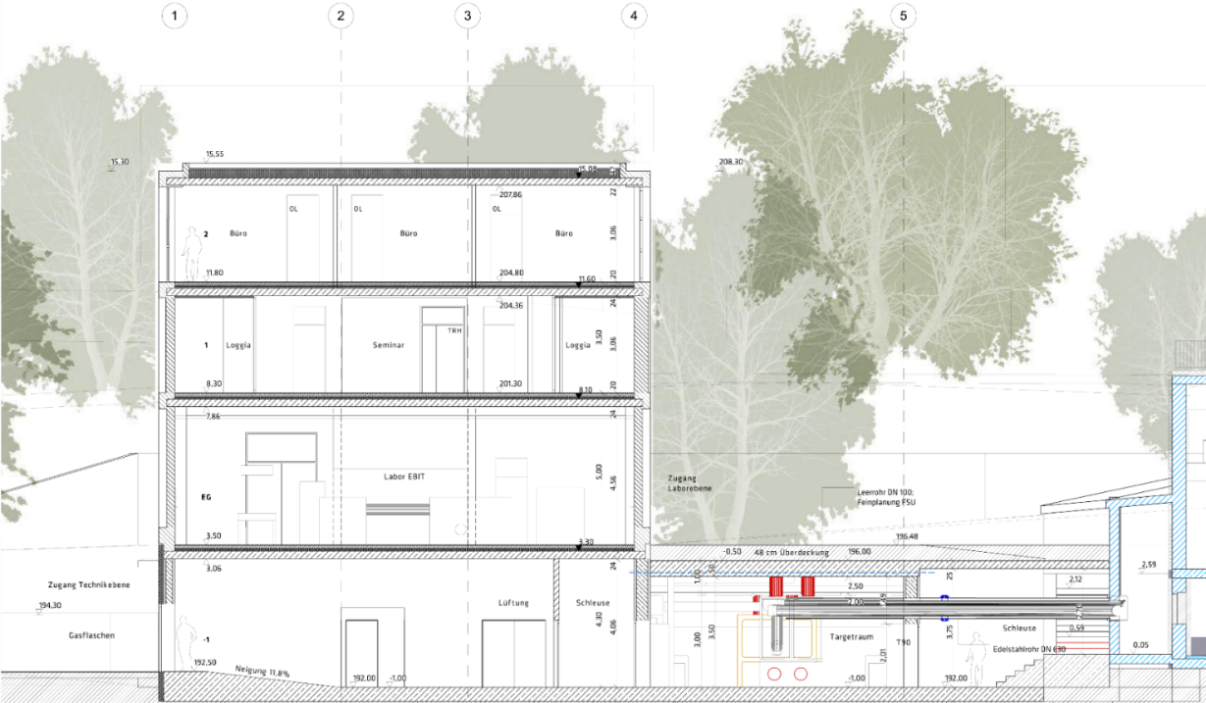
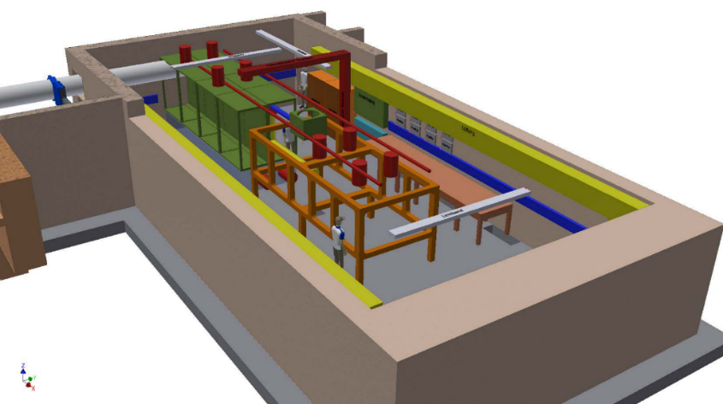
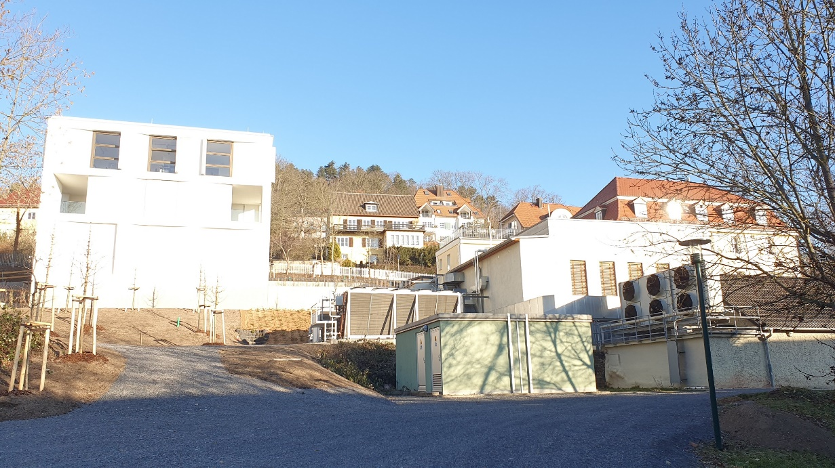
New institute building and challenges
Motivation: worldwide unique research infrastructure with two fs high-intensity laser systems and one EBIT (electron beam ion target)
Technical challenge: temporal and spatial synchronisation:
100 fs correspond to 30 µm Focus size is a few µm => high demands on stability

Slide 6
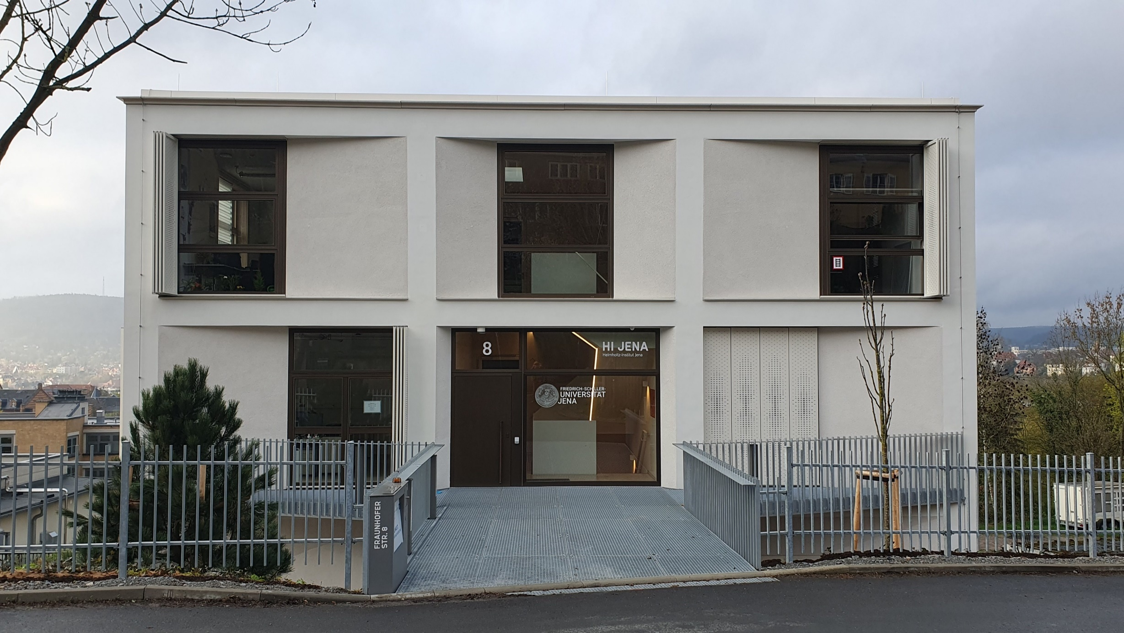
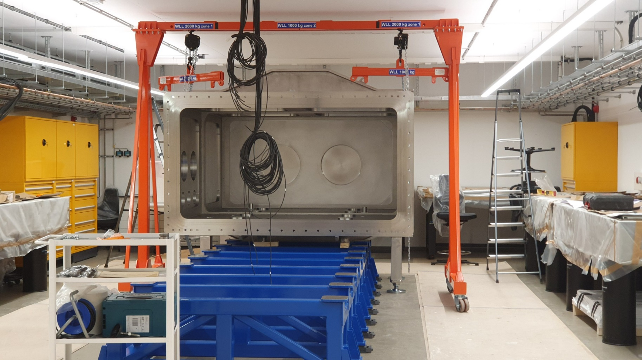
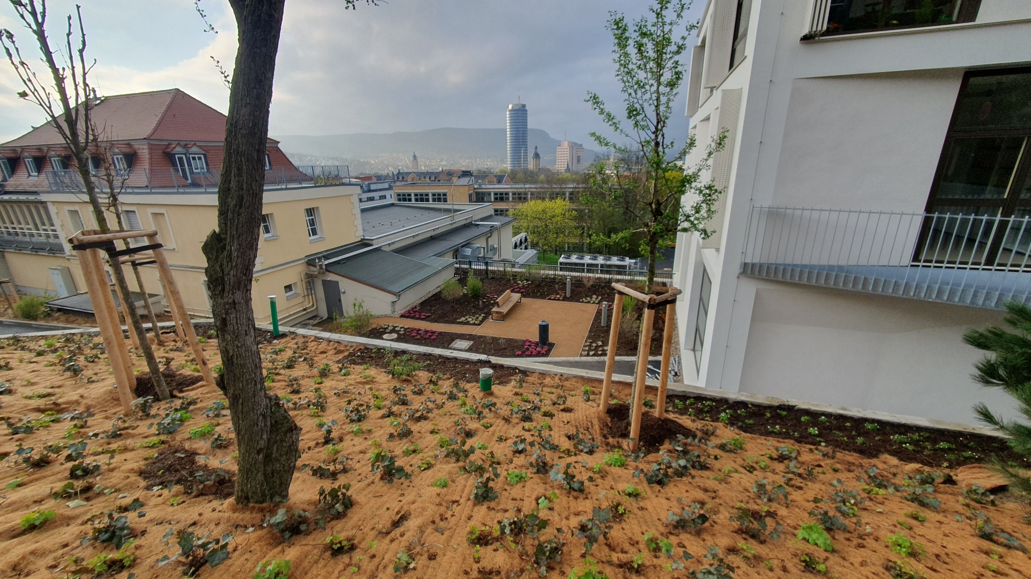
New institute building and challenges
Whole System became complex -> sophisticate CS is needed!
The jellyfish of choice: CS++ , EPICS, TANGO?
We (Dominik Hollatz) look intensive at Tango- Controls
Learn core functions (used terms are confusing…)
Cooking recipe for device drivers
Creating Docker based installation for easy deployment

Slide 7
Tango-Controls, a very beginner’s view
PRO:
high degree of scalability
Brings a set of SCADA functions
  Logging
  Alarming
  Archiving
supports C++, Python, Java, ( LabVIEW )
Provides code generators for supported Lngs.
Tries to use state of the art Web-standard
(TARANTA: configurable UI in Browser)
quality of live improvements (responsive GUI, remote control)
open source aspect (no license, full access)
Smooth change to for us: utilize the Tango-LV Bindings
CON:
hard start, initial amount of work is considerable
Sticks on CORBA as message broker
Babylonian confusion of languages
LV-Bindings are available, but not maintained anymore
a new system needs to be accepted and staff needs to be trained
a new system always has issues and bugs at the start
Windows installer is available, but typically old
Switch to Linux is needed
requires dedicated staff

Slide 8
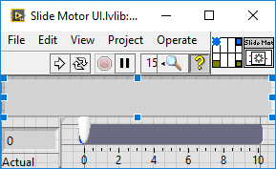
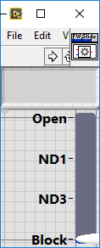
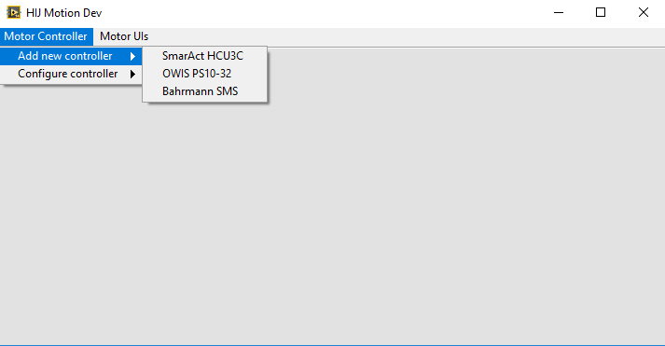
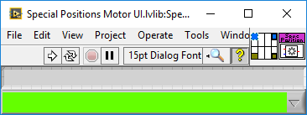
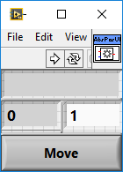
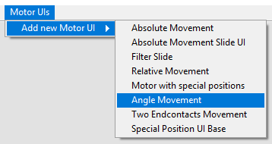
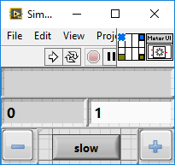
Some LabVIEW Stuff ☺ Dynamic UIs @ RT
Current version: LabVIEW 2020 SP1
Cool feature: Interfaces
replace abstract messages (in most cases ;-) )

Slide 9
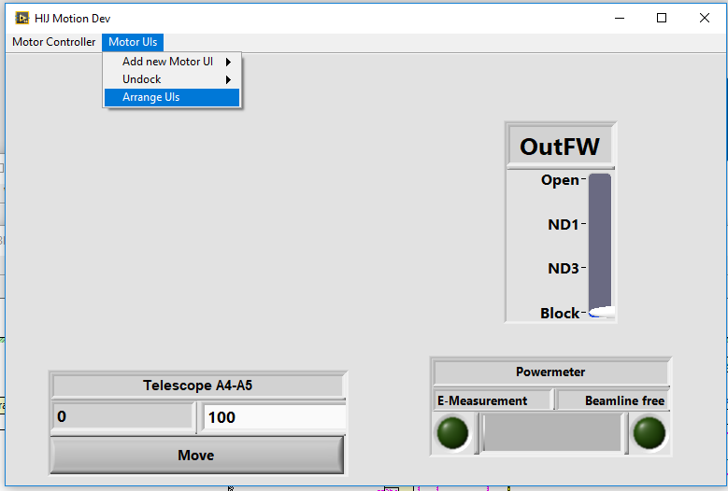
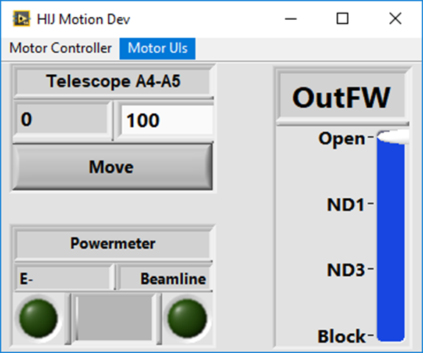
Dynamic UIs @ RT, Realisation
Viewable Actor as Parent Class https://git.gsi.de/a.kessler/ViewableActor.git or https://github.com/keale/Viewable_Actor
  Functions: Insert Into SubPanel, Remove from SP, Open FP, Set Window Title, Memorize last window size and position
The container contains a set of invisible SPs
Memorize last SP position
Example: HIJ Motion General App
https://git.gsi.de/a.kessler/HIJ_Motion

Slide 10
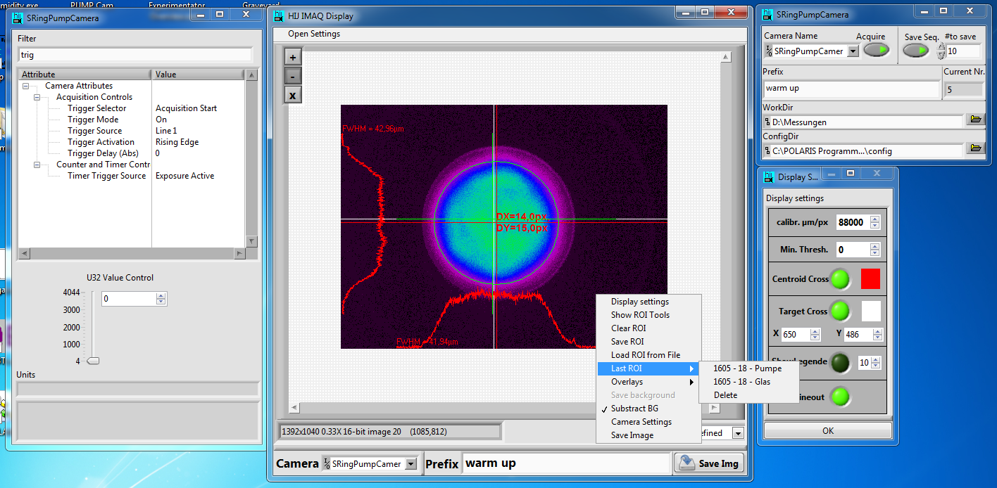
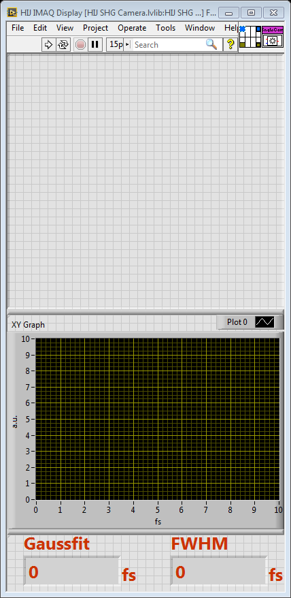
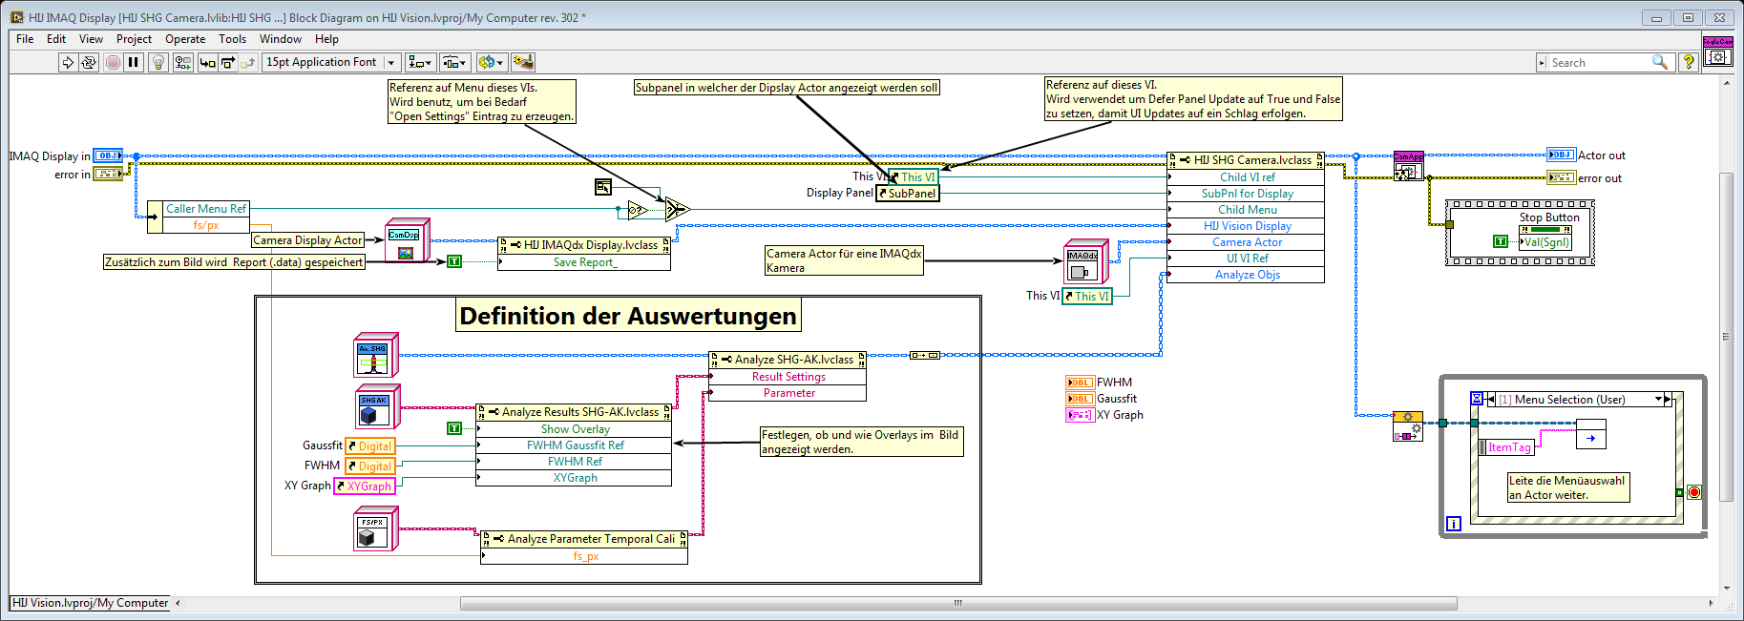
HIJ-Vision
https://git.gsi.de/HIJ_Vision
Main goal: library for easy development of typical Laserlab camera applications

Slide 11
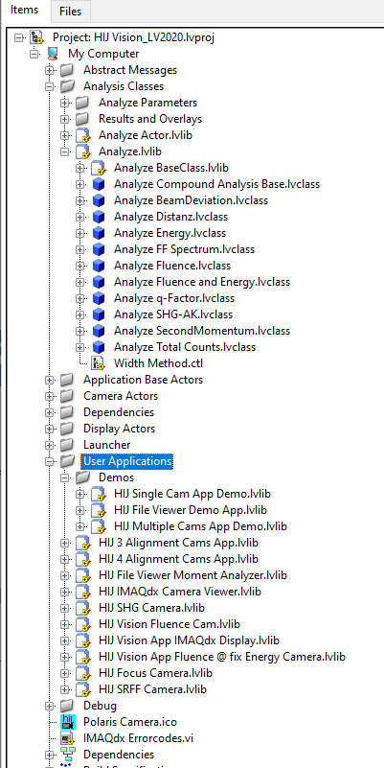

HIJ-Vision
HIJ Vision
Clean separation between
  Camera driver (IMAQdx)
  Analysis
  Display
The BIG QUESTION: How we can replicate LV App with open source alternatives?
OpenCV + Python?
https://opencv.org/
Harvester + GUI+ Python?
https://github.com/genicam/harvesters
Camera Actor
  + IMAQdx Actor
Display Actor
  IMAQdx Display
  File Display
  … Display
Analyze Actor and Analyze classes
Application Actors

Slide 12
On the long way to F.A.I.R. data
F.A.I.R. Principles:
[Wilkinson, M. D. et al. https://doi.org/10.1038/sdata.2016.18]
  Findable (POI¹, rich MD², registered in global Catalog )
  Accessible (via standardized com. Protocol )
  Interoperable (common Language for Knowledge Representation)
  Reusable (License, Provenance, Community Standards)
The F.A.I.R. Principles for HELIPORT: https://heliport.hzdr.de/principles/
¹ Persistent Object Identifier; ² Meta Data
???

Slide 13
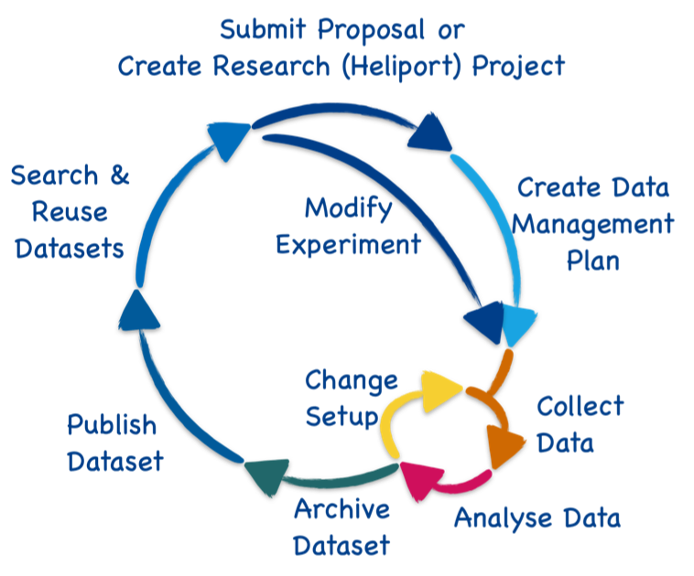


HELIPORT Project
HELmholtz ScIentific Project WORkflow PlaTform
https://heliport.hzdr.de/
“HELIPORT aims at developing a platform which accommodates the complete life cycle of a scientific project and links all corresponding programs, systems and workflows to create a more F.A.I.R. and comprehensible project description”
Computational
Workflow
Founded by:
Founded by:

Slide 14



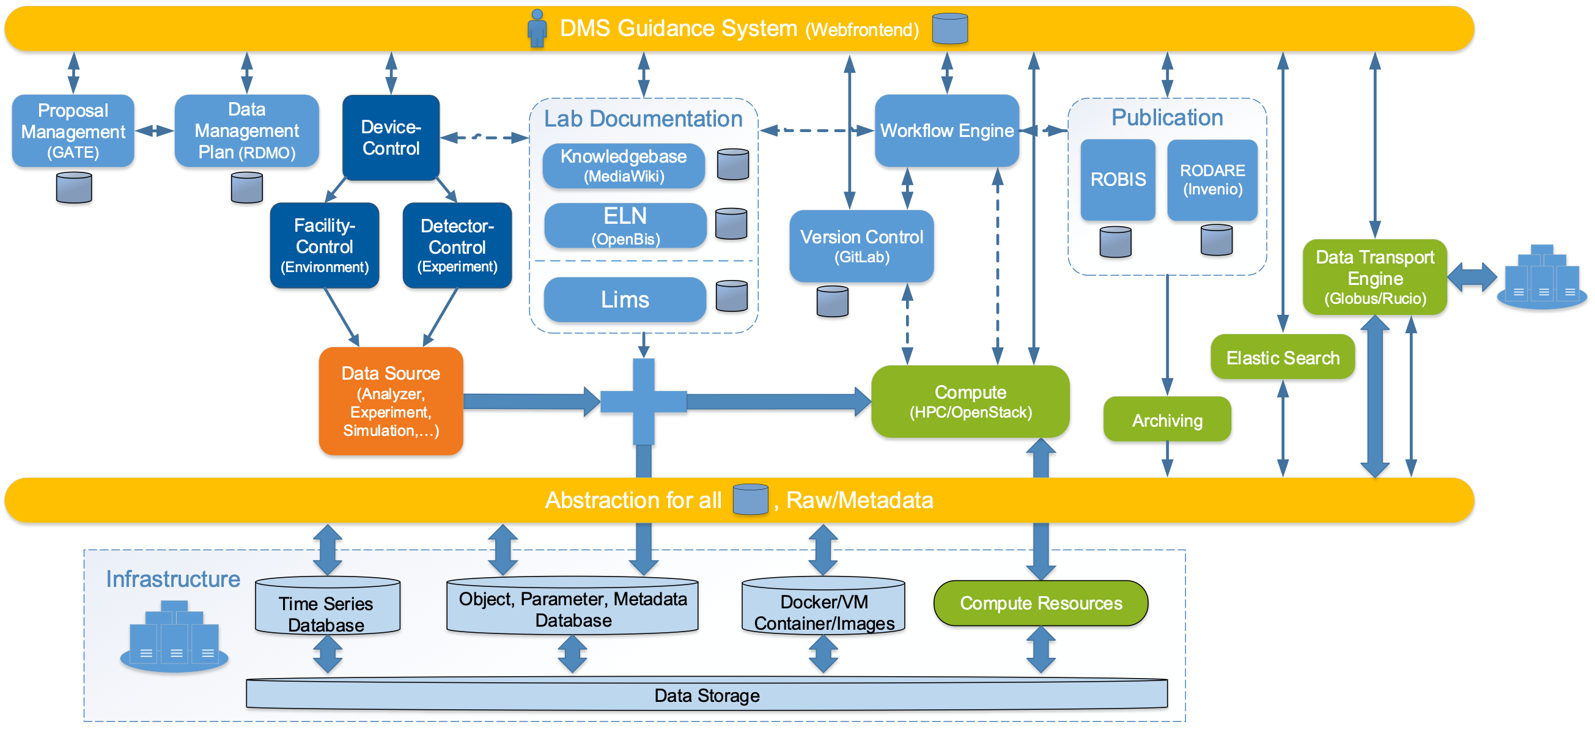
HELIPORT, the Idea behind
  The HZDR IT infrastructure can support various experiments, but it is complex…
  Scientists often don’t know which services are available and how to use them.
  An overarching system guiding scientists (and visitors) through the lifecycle of their research project (and our services) is inevitable.
  The concept of F.A.I.R. research becomes an important topic for scientists.
!
Data Management Guidance System
Doc
Interface to our Infrastructure Resources

Slide 15
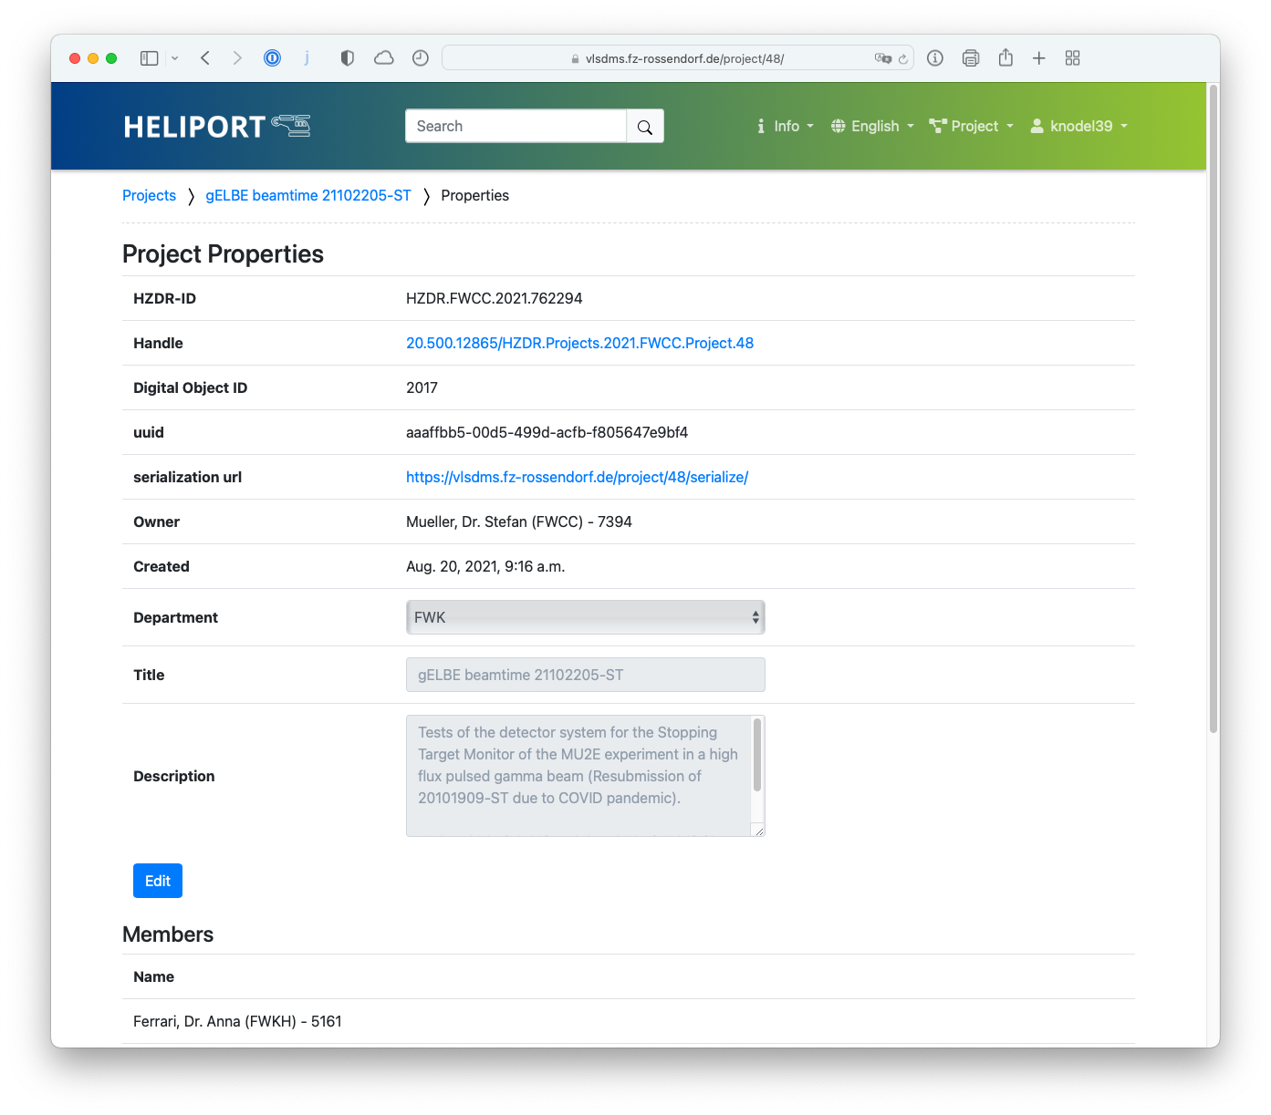
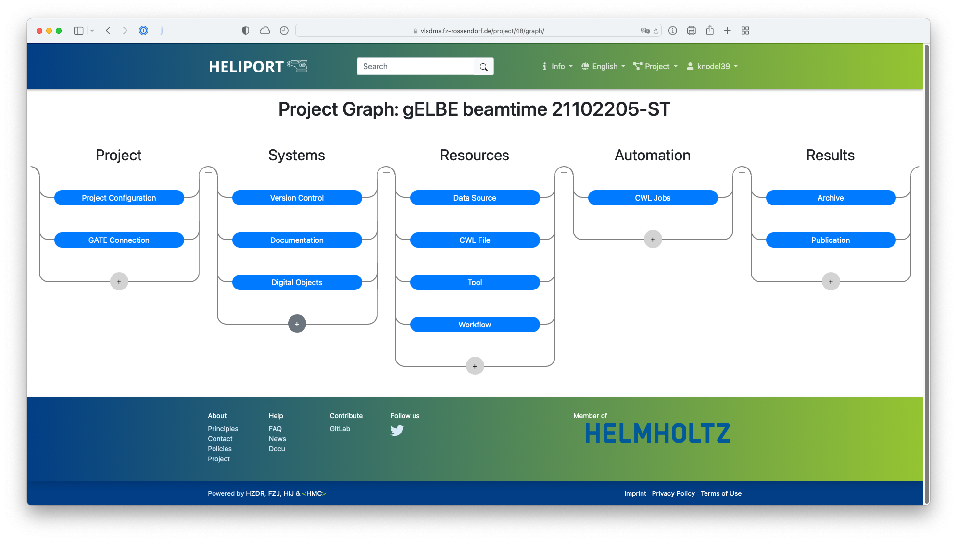
HELIPORT Web User Interface
Notes:
The idea behind Heliport is to look from far atop down to our project. When I’m new to a project I see all the necessary resources and documentation. Her we can also add for instance references useful for the experiment such as an external website or a related e-learning course.
Here we see a screenshot of our web interface:
Project: The typical start of a project contains title, abstract, members and the generated persistent identifiers. In this stage also the linking of the initial proposal occurs.
Systems: A System referred to in this stage can be a link to a project on a version control system or platform (e.g. the Helmholtz GitLab instance), a data management system, or a system used for documentation (e.g. MediaWiki, . . . ).
Resources: Project resources include descriptions of work- flows and tools that are used to process data, as well as the (raw) data itself.
Automation: Here, the execution schedule, monitoring and logging of tools and workflows is defined.
Results: In this stage the scientific results can be added to the project. A result can be a scientific publication, the publication of a (new) version of the project’s metadata, or an archive of specific data products.
Then we have here everything in one place which is used in the project. A first point where a new scientist can get in touch with the project and the used or available resources. For a FAIR project we can export the overall project metadata.
Today I will present the roadmap for a Heliport instance at the Helmholtz Institute Jena

Slide 16
Shot DB: new Approach with SciCat
Historical approach: adapt PHELIX Shot DB for POLARIS Lab
Problem: PSDB is designed for static laser system
We need highly flexible DB for experimental data!
… and Ruby(OnRails) is not a native language for me…
New Approach: rewrite UI with Python Django (same code base like HELIPORT)
Go to document oriented data storage

Slide 17
Shot DB: new Approach with SciCat
SciCat is a Metadata Catalog developed by MAX IV, PSI and ESS
Uses MongoDB as backend
Provides powerful search function
Use LoopBack framework and offers HTTP REST API
… and API Explorer for playing around and test
=> no need for ODBC drivers like for MySQL!
Lesson I learned: LV2020 has bad HTTP REST Support! No PATCH function!

Slide 18
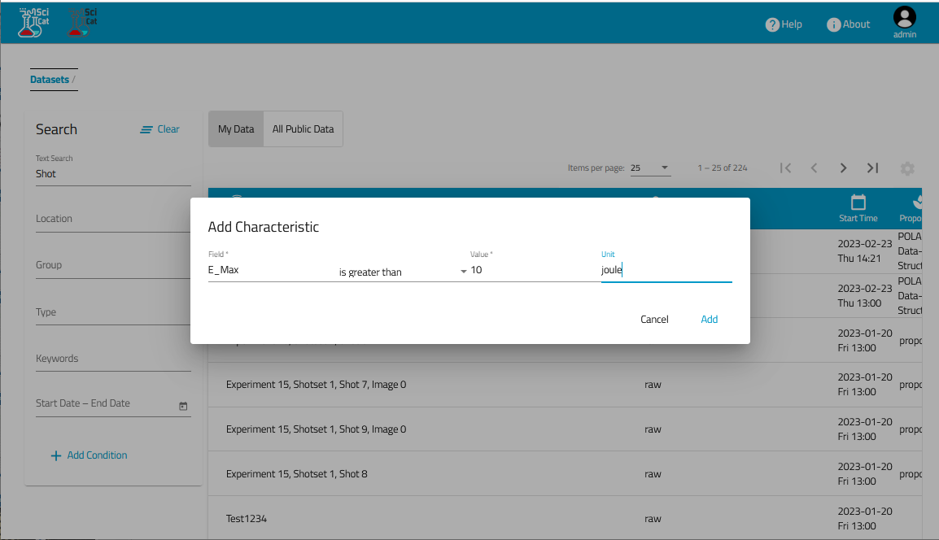
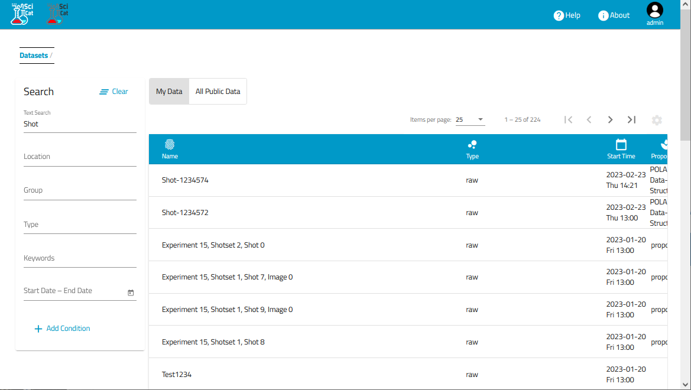
Shot DB: new Approach with SciCat

Slide 19
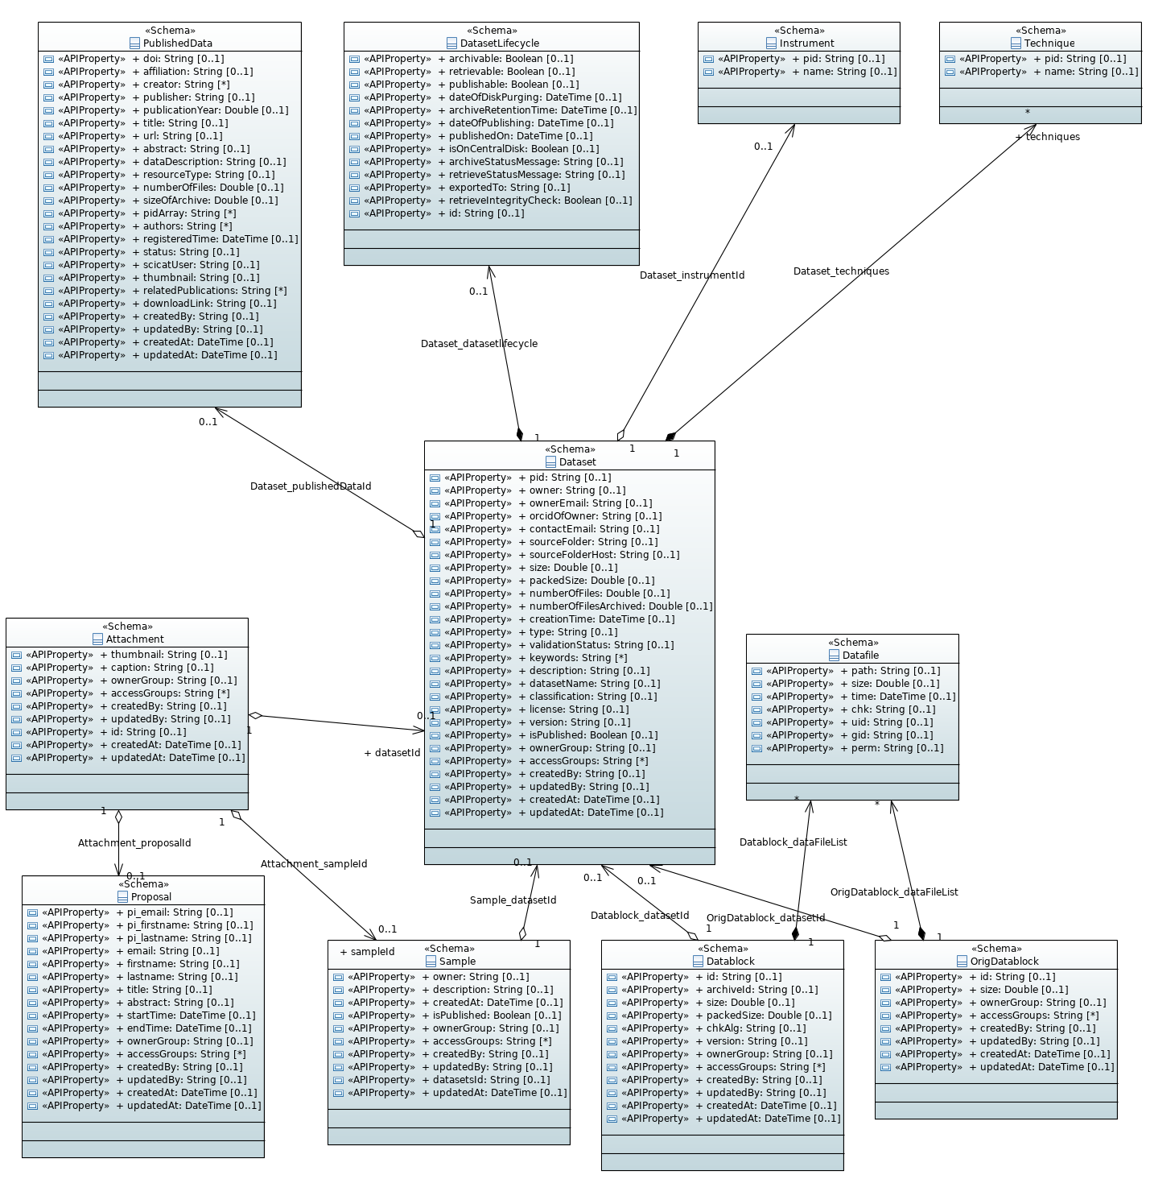
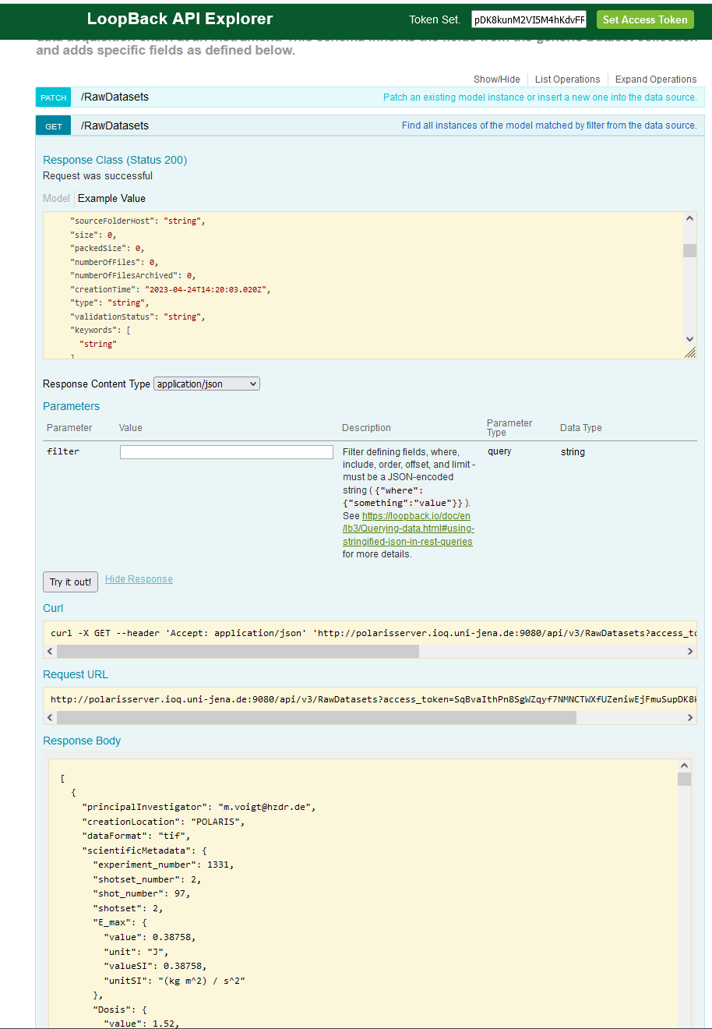
Shot DB: new Approach with SciCat

Slide 20
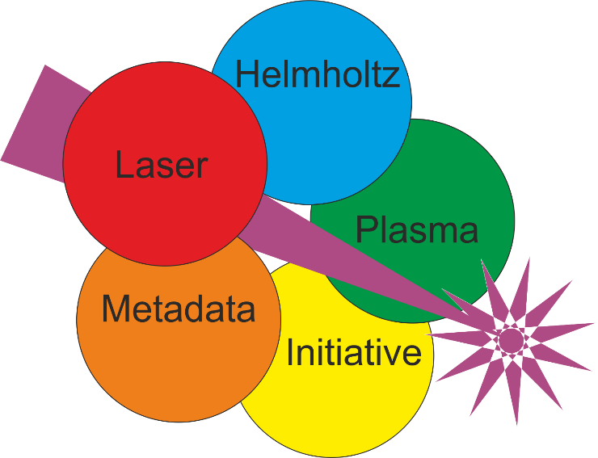


HELPMI: Helmholtz Laser-Plasma Metadata Initiative
  Develop F.A.I.R data standard for LP community
    Develop vocabulary for laser-plasma experimental data
    Extend existing openPMD standard and API towards experimental data
      Make openPMD extensible
      Adopt design of existing NeXus standard (from Photon-Neutron experimental community)
        E.g. experiment geometry data, incremental analysis
      Apply vocabulary and design features to openPMD
        Possibly interchangeable/-operable with NeXus
  Generalized and F.A.I.R. data standard for whole LP community (simulations and experiments)
  Connect with Photon and Neutron science community

Slide 21
How to proceed? My wishes:
Thin installation! In best case just a browser is enough!
  Huge installation on each PC (at least LV RT!) looks like stone age…
Free configurable UI (e.g. Tango-Control Taranta)
Visual programming! (Blockly, Scratch, Node-RED, ?....?)
  Well, C++, Python and co. are sure powerful. But they have a high entry threshold!
  Scientists should focus on science, not on SW development!

Slide 22
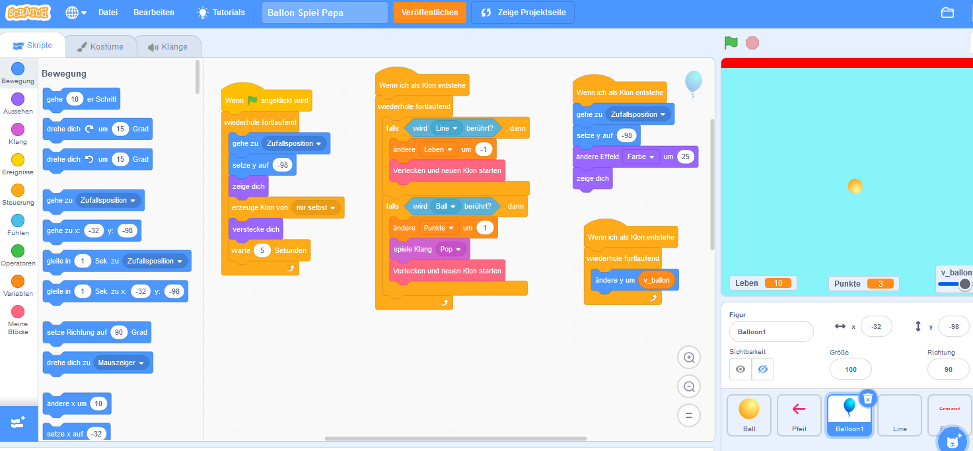
Something like e.g. Scratch
Programming Language for Kids
… well, I heard the same about LabVIEW ☺
E.g HIJ-Vision: Image Analyze Classes are Blocks in Scratch or Blockly
The BIG ? : Do the benefits outweigh the effort?

Slide 23
News from HI-Jena
Thank You for your attention!

